Slide 1
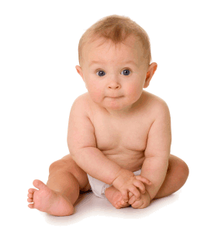
pediatrics
Chapter 9

Slide 2
Childhood diseases
Play the disease game
Why don’t they do it in their sleeve:
https://www.youtube.com/watch?v=CtnEwvUWDo0

Slide 3
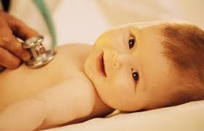
Well child visit
2. The components of a well child visit are:
Health maintenance
(Shots, ear & eye checks, measurements, vitals etc.)
Guidance

Slide 4
Schedule of visits
P 234
Months
1,
2
4
6
9
12
15
18
24

Slide 5
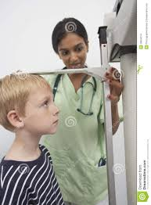
MA does the:
Measurements
Shots
Vitals
Eye and ear checks

Slide 6
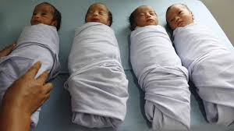
Carrying and wrapping an infant
Demonstrate how to:
wrap an infant
Carry an infant

Slide 7
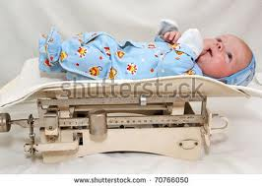
9-1 video measuring wt and ht
16 oz = 1 lb
½ pound is
8 oz
¼ lb is
4 oz

Slide 8
Length
Inches
¼, ½, ¾
Centimeters
0.5

Slide 9
Head circumference
Practice measurements
Growth percentiles

Slide 10
Growth percentiles
Is baby growing normally?

Slide 11
Infant CPR

Slide 12
Pediatric urine collector

Slide 13
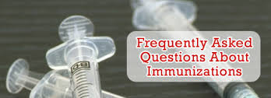
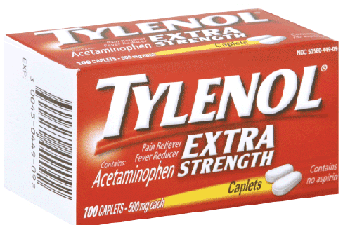
Is it OK to Immunize with a:
A) cold? yes
B) Ear infection? yes
C)Low grade fever? Yes
2. Kids should get a Hep A
If fussy give
Tylenol
2.If tender use a
cold compress
3. If spots develop give Tylenol
Keep him home
He is contagious
4. MMR can cause a fever
5. If fever develops give
Tylenol –
a) There is a very small risk
If DTaP leads to child collapsing and crying constantly
Go to Emergency Room
The common name for Acetaminophen is Tylenol

Slide 14
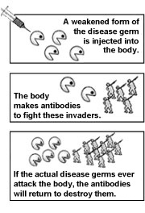
Immunizations

Slide 15
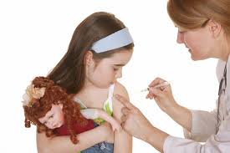
How Vaccines work
https://www.youtube.com/watch?v=s_6QW9sNPEY

Slide 16
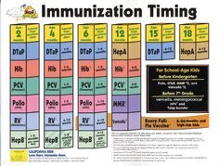
Ages

Slide 17
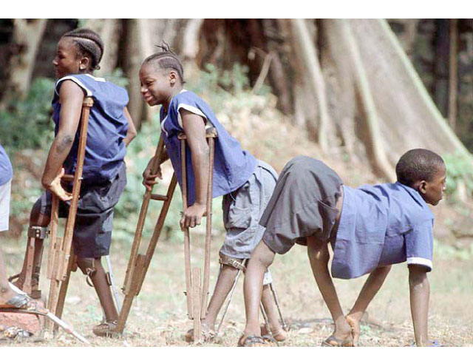
vaccinations
Polio
https://www.youtube.com/watch?v=x57G0gV7zV0

Slide 18
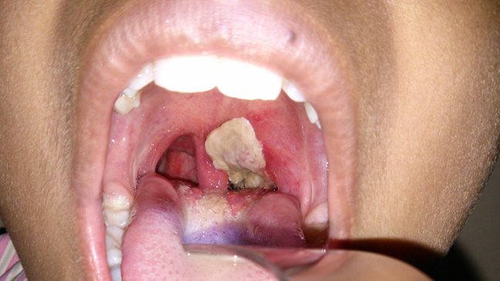
vaccinations
Diphtheria
https://www.youtube.com/watch?v=vO3lapIK7uY

Slide 19
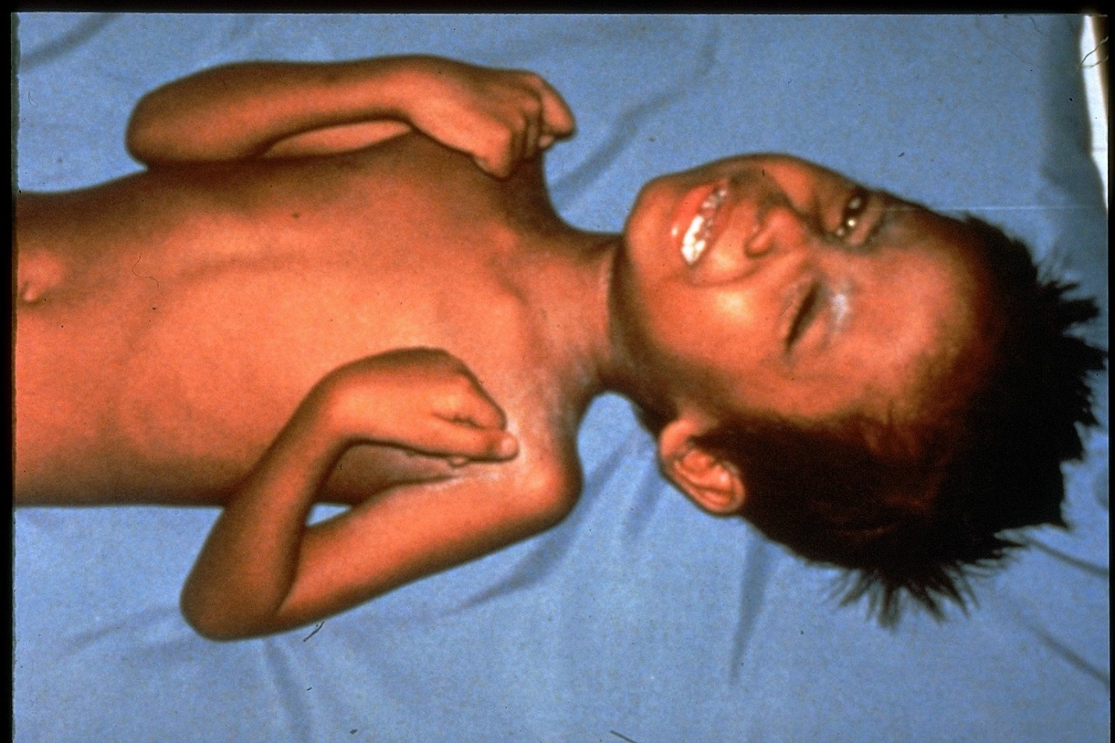
vaccinations
Tetanus
https://www.youtube.com/watch?v=RG9kR3rYZzA

Slide 20
How does a person get tetanus
From a bacteria that lives with no air
Anaerobic
2. match the symptoms
3. Dtap is used now because it is safer
4.
2, 4,6, 18 months
5. don’t get a shot if you are
sick,
allergic to it or
have a weak immune system
6. adults
yes
7. mild problems
fever and rash
9. treat with
Tylenol
10.
cold compress and Tylenol

Slide 21
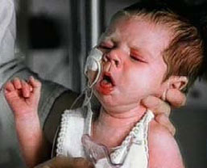
vaccinations
Pertussis
https://www.youtube.com/watch?v=VX98aiYpmW4

Slide 22
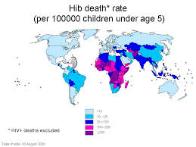
vaccinations
Hib (causes meningitis)
like pneumococcal vaccine
https://www.youtube.com/watch?v=xNbVjCdvrdA

Slide 23
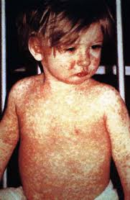
MMR while pregnant
https://www.youtube.com/watch?v=eMJiFa4Mams

Slide 24
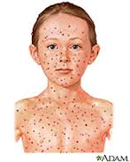
Varicella
Chicken pox, Varicella And shingles
https://www.youtube.com/watch?v=raQpDDU4xmk

Slide 25
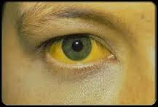
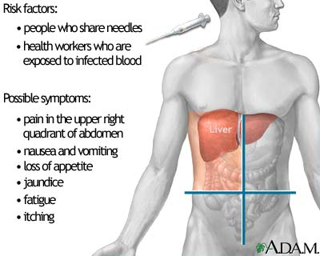
Hep A & B
Hepatitis A and B and how the liver works
https://www.youtube.com/watch?v=Q9L7ZQPc8EA

Slide 26
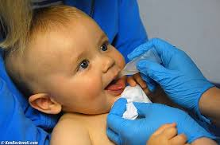
Rotavirus
Given orally
https://www.youtube.com/watch?v=aaxcmEvfnDY
https://www.youtube.com/watch?v=zCPdoBOeU6Y

Slide 27
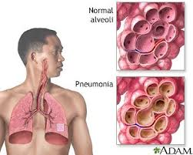
Pneumococcal
https://www.youtube.com/watch?v=ij6jMchYyFE
Sepsis
Poison in the body

Slide 28
Angle of Insertion
___________ ___________ __________
IM SC ID

Slide 29
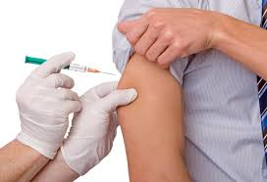
Practice recording shots
Joseph is 2 month old and here for his shots
on the picture
Record where you gave the shot and date
in the work- book
Record the shot info
If you have no lot number use # 1234, manufacturer Abbot lab
VIS statement information
Date that it was written and the date you gave (today)

Slide 30
Practice
SC shots IM shot

Slide 31
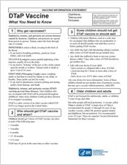
Vaccine information statement
VIS sheets must be given for each shot
Made by the government
Date written is at the end of the sheet
Must record the date the VIS was written on the chart
Also record the date you gave it to the pt.
http://www.cdc.gov/vaccines/hcp/vis/vis-statements/dtap.pdf

Slide 32
TETANUS

Slide 34
PERTUSSIS = WHOOPING COUGH

Slide 35
DTaP
3. attenuated DTaP is now used because it is
SAFER
4. the schedule is
2,4,6,18 Months & 6 years
5. You should not get a shot if you are
very ill or allergic to it
6. Adults do need a booster
7. Mild problems may be
Fever, redness, soreness
9. If you have a mild fever
give aspirin-free pain reliever
10 If you have a bad reaction
go to the doctor or 911
1-800-822-7967.

Slide 36
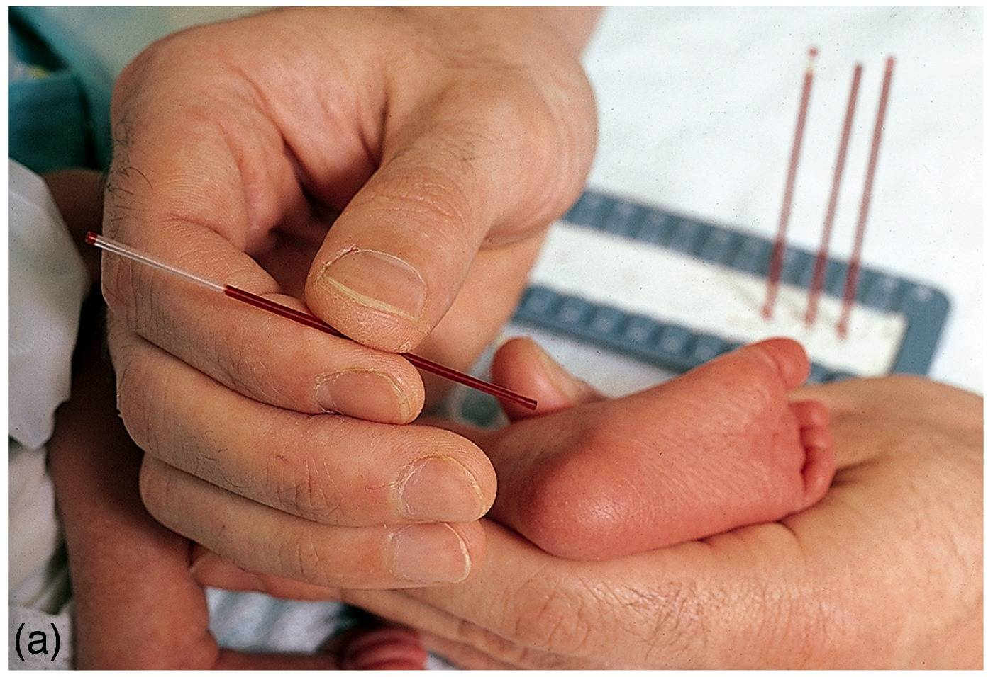
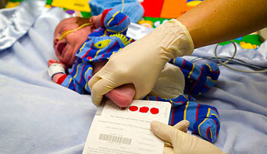
Newborn Screening Test
Stick on either side of the heel
28. Screens for:
_PKU and
Sickle Cell Anemia
29. Symptoms of PKU are:
mental retardation and
poor muscle control
30. Formula contains Phenyl al anine
( which the PKU lacking baby cannot convert to food.)

