Slide 1
Chapter 2
https://www.osha.gov/OshDoc/data_BloodborneFacts/bbfact01.pdf
This chapter discusses OSHA’s Bloodborne Pathogens Standard‘s requirements
regarding what employers must do to protect workers who are occupationally exposed to blood or other potentially infectious materials (OPIM).

Slide 3
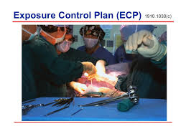
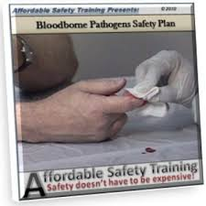
1. Implement 2. Train
Employees are expected to:
Establish an written “Exposure control plan” (ECP)
Training must be every year (annually).
A record of it must be kept.

Slide 4
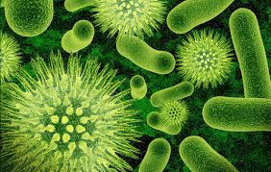
3. BE AWARE of Bloodborne Pathogens: Microorganisms
The training includes dangers from Bloodborne Pathogens.
Microorganisms are tiny plants and animals that you can only see with a microscope
Nonpathogens are those that do no harm to us
Pathogens (germs) can cause disease
Medical asepsis
Means “Free from germs or pathogens”
Bloodborne pathogens are pathogens carried in the blood or other potentially infectious materiel (OPIM) such as
Mucous
Semen
Tears
Breast milk
Vaginal secretions

Slide 7
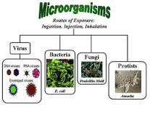
Types of Microorganisms
Types of Bacteria

Slide 8
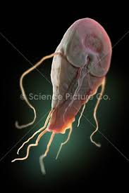
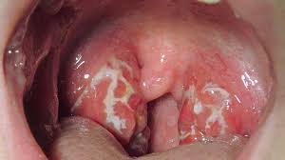
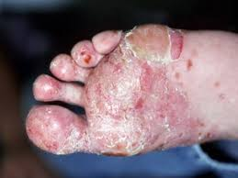
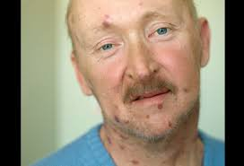
4 types of microorganisms
Strep throat is caused by a bacteria
HIV / AIDS is caused by a virus
Giardia (intestinal problem) is caused by a protist
Athletes foot is caused by a fungus

Slide 10
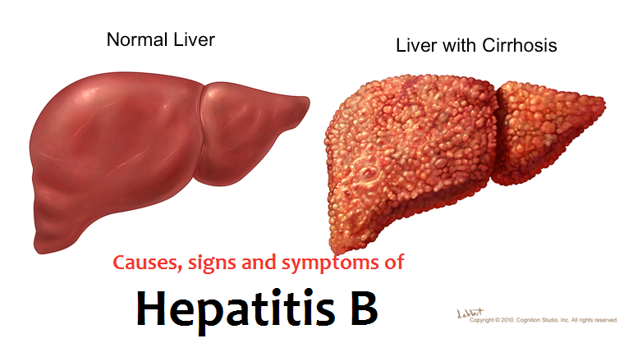
Hepatitis
The most common means of transmitting Hepatitis B at work is needle sticks
The best way to prevent infection of Hepatitis B is vaccinations
There is a series of 3 shots:
Initial
One month later
6 months later

Slide 11
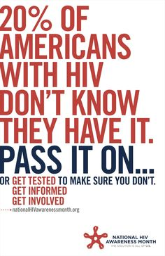
HIV is a virus which leads to AIDS
Two ways to get AIDS
are sharing sex and needles with someone who has it
AIDs is defined as:
HIV positive and a T cell count of less than 200
Normal T cell is about 1000
Because a person with AIDs has little or no immunity they can die of any other disease.
There is no cure and no vaccination

Slide 12
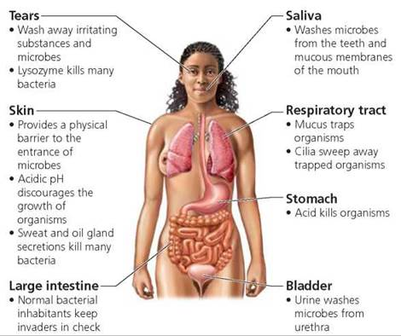
Protective mechanisms of the body

Slide 13
LABELS
BIOHAZARD LABELS MUST BE PLACED ON:
Sharps containers
Biohazard bags
Any box or receptacle that will contain biohazard materials
They will be picked up by a special company to be disposed of safely

Slide 14
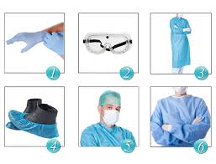
Controls; workplace practice personal protective equipment

Slide 15
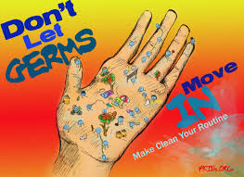
Controls; workplace practice CDC Guidelines for Hand Hygiene CDC = Center for Disease Control (Government)
Wash
When you see dirt
Before eating
After the restroom
Alcohol (sanitizer)
Before and after patients
Before and after gloves
After body fluids or equipment

Slide 16
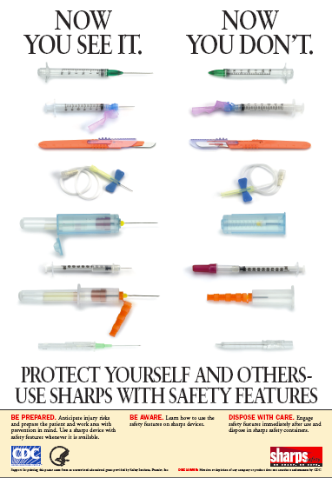
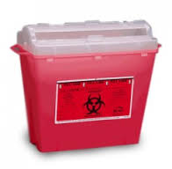
Engineering controls
Equipment or supplies designed by an engineer to keep us safe
Safety needles
Sharps containers

Slide 17
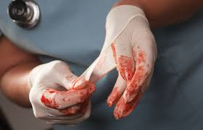
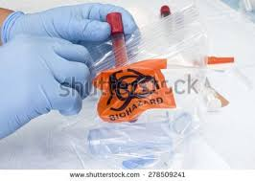
Disposal of Regulated Medical Waste

Slide 18
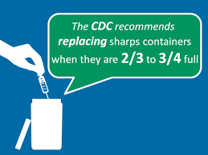
Post exposure prophylaxis
If you stick yourself with a contaminated needle, what are the first 3 things to do?
1. first aid
2. tell your boss
3. go to the doctor

