Slide 1
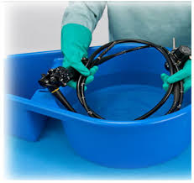
Chapter 3 Sterilization & Disinfection
Sanitation
Wash
Decontaminate
Remove or destroys pathogens
Detergent
soap
Disinfectant
A chemical that removes pathogens
Spore
A thick walled capsule around a germ
Sterilize
Use a sterilizer or autoclave

Slide 2
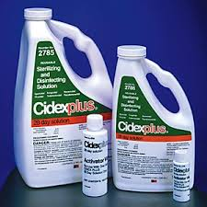
Hazardous Chemicals
MSDS sheets tell about hazardous chemicals. This one is about CIDEX
For example:
Cidex or Glutaraldehyde should be WASHED DOWN THE DRAIN
If it splashes in your eye you could FLUSH WITH WATER FOR 15 MINUTES

Slide 3
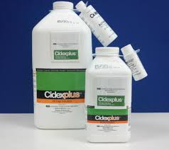
STORING DISINFECTANTS
Shelf life
EXPIRATION DATE
Use (& Reuse) life
How long it is effective after being MIXED
E.g. Cidex is good for 28 days after mixing
Bleach good for ½ hour.

Slide 4
Disinfectant levels
Level | Kills | Use | example
High | All microbes, virus & fungi except spores | Semi-critical items that go inside you e.g. a Flex sig | Glutaraldehyde (Cidex)
Intermediate | Most microbes, virus & fungi Except spores | Non – critical items that touch you e.g. stethoscope | alcohol
low | Most microbes but not TB or spores | Surfaces of tables etc. | Household bleach

Slide 5
Types of Disinfectants
Chlorine (bleach)
10% solution is best
Kills TB, HIV & hepatitis B &C
Lasts for 10 minutes
OSHA recommends it for blood spills
Phenolics
For walls, furniture
E.g. Lysol
Glutaraldehyde
E.g. Cidex
Semi critical items that can’t be autoclaved
Alcohol
70% solution is best
Intermediate to low
For Stethoscopes

Slide 6
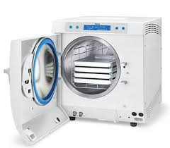
STERILIZATION
Fill out the log
from page 111
Watch an autoclave demonstration
Care for the autoclave
Wipe inside and out with autoclave cleaner, rinse & dry
Clean and check the rubber gasket around the door
Only use distilled water

Slide 7
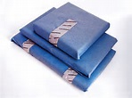
Autoclave
On the wrap write:
YOUR NAME,
DATE
WHAT’S INSIDE
Start timer when at right temperature
Muslin is best:
lies flat
can be reused.
Steam should get around the items & inside.
1 to 4 inches apart
Not touch the walls
Jars on their side
Lids removed

Slide 8
Sterlization indicators
Autoclave tape
On outside
Changes color when exposed to steam
Sterilization strips
Change color when exposed 250F for 15 minutes
Should be placed in center of wrapped pack
Biologic indicators
CDC says use once a week
Live spores in small envelopes.
Harmless to humans
To see if it works, compare color of steamed ones with the control.

Slide 9
Other sterilization methods
Dry heat oven
Used if steam would damage an item
320 for 1 or 2 hours
Cold sterilization
Only use chemicals rated “sterilants” by the EPA
Leave the instrument in it for 6 to 24 hours

Slide 10
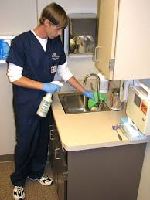
REVIEW
To Sterilize you :
Use a sterilizer
To Disinfect you :
Use chemicals
To Sanitize you:
wash

