Slide 1
Unit 1
The Integumentary System

Slide 2
Class Overview

Slide 3
Present
Importance of the Clinical Setting and the Role of the MA
The Integumentary System

Slide 4
Importance of the Clinical Setting and the Role of the MA
Role of the Medical Assistant
Responsibilities of the Medical Assistant
Clinical Competencies Associated with the Integumentary, Urinary and Reproductive Systems
Affective Skills associated with Clinical Competencies and Patient Education/Instruction
Importance of Medical Terminology, Anatomy & Physiology, Coding
Notes:
Use real-world examples to connect the clinical procedures of a medical assistant to the concepts covered in this course.
Remind students of the program structure. In the color modules: red, green, purple and yellow, clinical competencies are pared with related body systems and coding practices.
There are several competencies that are repeated (i.e. vitals and injections) purposefully. Provide students insight into why these skills need to be practices to maintain their skill level.
Focus this discussion on the skills involving the body systems for this course: The Integumentary System, Urinary System and Reproductive System

Slide 5
Discussion
MA Skills and Tasks

Slide 6
Lecture
The Integumentary System

Slide 7
The Integumentary System
Notes:
7
Functions: Protection
Regulation
Sensation
Absorption
Secretion
Protection
Forms 2-way barrier
Keeps out:
Pathogens (disease-causing organisms)
Harmful chemicals
Prevents critical body fluids from escaping the body
Protects internal organs
Aids in regulation of body temperature
To release heat, superficial blood vessels in skin dilate, bringing more blood to surface of skin
To conserve heat, superficial vessels constrict, keeping warm blood away from surface
Continuous fat layer of subcutaneous layer acts as insulation
Detect:
Temperature
Pain
Touch
Pressure
Are located in skin
Nerve endings in the middle layer of skin convey messages to the brain and spinal cord
Sweat glands
Sebaceous glands
Hair
Nails
Weighs more than 20 pounds (in an adult)
Covers 16% of the body
Purposes:
Protection
Regulate temperature
Absorption
House nerve receptors
Secrete fluids
Factoid
The skin is the largest organ in the body!

Slide 8
Three Layers of the Skin
Layers of skin relate to types of injections.
Notes:
8
Epidermis is the thin, outer membrane layer
Dermis or “true skin”, is the middle, fibrous connective tissue layer
Subcutaneous is the innermost layer, containing subcutaneous tissue
Stratum corneum
Outermost layer of skin consisting of dead cells filled with a protein called keratin
Forms a protective covering for the body
Thickness of the layer depends on the part of the body
Stratum lucidum
Translucent layer lying directly beneath the stratum corneum
In thinner skin, it is often absent
Cells in this layer are either dead or dying
Stratum granulosum
Consists of several layers of living cells that become part of the stratum lucidum and stratum corneum
Cells actively become keratinized or hardened, after they lose their nuclei
Stratum germinativum
Made of several layers of living cells, still capable of mitosis, or cell division
Most responsible for the regeneration of the epidermis
Stratum granulosum
Consists of several layers of living cells that become part of the stratum lucidum and stratum corneum
Cells actively become keratinized or hardened, after they lose their nuclei
Stratum germinativum
Made of several layers of living cells, still capable of mitosis, or cell division
Most responsible for the regeneration of the epidermis
Middle layer of the skin
Composed of
Connective tissue containing nerves and nerve endings
Blood vessels
Sebaceous and sweat glands
Hair follicles
Lymph vessels
Further divided into two layers: Papillary layer and reticular layer
Composed of subcutaneous tissue
Tissue helps support, nourish, insulate, and cushion the skin

Slide 9
Accessory Organs
Notes:
9
Hair
Hair follicles
Hair root
Hair shaft
Fibers composed of the protein keratin
Hair formation like the growth in the epidermal layer of skin
Melanin gives hair its color
Sebaceous glands release sebum into hair follicles

Slide 10
Nails
Notes:
10
Flat plates of keratin
Called nail body
Cover ends of fingers and toes
Connected to tissue by nail bed
Grow longer from the rootsCovered and protected by cuticle
Free edge is exposed edge
Light colored half-moon area at the base is the lunula
Factoid
Nail beds can tell low oxygen levels in the blood.

Slide 11
Sebaceous Glands
Open into hair follicles
Secrete the oil sebum
Lubricates hair and skin
Prevents drying and cracking
Notes:
Sweat glands
Assist body in maintaining internal temperature
Create cooling affect when sweat evaporates
Sebaceous glands
Oil glands
Produce sebum
Lubricate the skin surface

Slide 12
How Skin Cancer Occurs
Occurs when normal skin cells undergo a change during which they grow and multiply without normal controls
As the cells multiply, they form a mass called a tumor
Tumors of the skin are often referred to as lesions
Malignant tumors encroach on neighboring tissues, especially lymph nodes, due to their uncontrolled growth
Notes:
Skin cancer is the most common of all cancers.
Skin cancer affects more than 1 million people each year in the United States.
Three major types:
Basal cell carcinoma
Squamous cell carcinoma
The vast majority of skin cancers are either basal cell or squamous cell carcinomas
Malignant melanoma
A small but significant number of skin cancers are malignant melanomas. Malignant melanoma is a highly aggressive cancer that tends to spread to other parts of the body.
These cancers may be fatal if not treated early

Slide 13
Pathology of the Skin
abscess | collection of pus in skin
acne | inflammation of sebaceous glands and hair follicles with papules and pustules
acne rosacea | chronic form of adult acne with redness and tiny pimples, primarily on nose
acne vulgaris | common form of teenage acne with comedo, papules, and pustules
albinism | genetic condition; unable to make melanin; white hair and skin, and red eyes

Slide 14
Pathology of the Skin
basal cell carcinoma | cancerous tumor in basal cell layer; common cancer; rarely metastasizes
burn | skin damage caused by fire, electricity, ultraviolet light, or caustic chemicals; percentage of skin burned is estimated by Rule of Nines

Slide 15
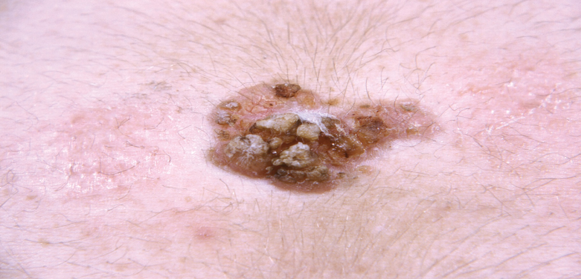
Basal Cell Carcinoma
Notes:
Most common form of skin cancer
Most often caused by overexposure to the sun
May often appear as a change in the skin, such as a growth, an irritation, or a sore that does not heal, or a change in a wart or mole
Though the nose is the most common site, it usually affects the head, neck, back, chest, or shoulders
Exposure to sunlight is the most common cause of this, and most cancers
Firm, pearly bump with tiny blood vessels in a spiderlike appearance (telangiectasias)
Red, tender, flat spot that bleeds easily
Small, fleshy bump with a smooth, pearly appearance, often with a depressed center
Smooth, shiny bump that may look like a mole or cyst
Scarlike patch of skin, especially on the face, that is firm to the touch
Bump that itches, bleeds, crusts over, and then repeats the cycle and has not healed in 3 weeks
Change in the size, shape, or color of a wart or mole

Slide 16
First Degree Burn
First degree burn | skin reddened and painful; no blisters; damage to epidermis

Slide 17
Second Degree Burn
Second degree burn | skin reddened and painful with blisters; damage to epidermis and dermis

Slide 18
Third Degree Burn
Third degree burn | skin charred; epidermis and dermis burned away; subcutaneous layer exposed

Slide 19
Pathology of the Skin
cellulitis | diffuse acute infection of connective tissue of skin
cicatrix | normal scar
decubitus ulcer (decub) | open sore caused by pressure over bony prominences; caused by loss of blood flow to skin
dermatitis | inflammation of the skin
dermatosis | presence of a skin condition

Slide 20
Contact Dermatitis
An allergic reaction of the skin caused by irritating substances coming in contact with it
Causes include exposure to poison ivy, poison oak, nickel (especially on jewelry or jean snaps), lotions, detergents, or other chemicals
Courtesy of Jason L. Smith, M.D.
Notes:
Signs and symptoms:
Red and irritated skin
Vesicles (small blisters) and rash may appear
Itching and pain may be present
Serious allergic reactions may result in urticaria
Treatments:
Antihistamines (antiallergy medicines)
Topical corticosteroid creams to reduce the inflammation
Systemic corticosteroids (oral medications)

Slide 21
Cellulitis
An acute spreading bacterial infection below the surface of the skin. A cut, an abrasion, or ulceration may precede cellulitis. Commonly appears in areas where there is a break in the skin. Can be due to local trauma, such as an animal bite.
Courtesy of Jason L. Smith, M D.
Notes:
21
Signs and symptoms include:
Erythema (redness), warmth, swelling, and pain. Fever, chills, and enlarged lymph nodes may also accompany this infection.
Treatments:
Antibiotics, such as derivatives of penicillin, that are most effective against the staph germ

Slide 22
Pathology of the Skin
dry gangrene | late stages of gangrene; affected area becomes dried, blackened, and shriveled
eczema | superficial dermatitis; redness, vesicles, itching, and crusting
gangrene | tissue necrosis due to loss of blood flow
ichthyosis | skin becomes dry, scaly, & keratinized
impetigo | highly infections bacterial infection with pustules that rupture and crust over
Kaposi’s sarcoma | skin cancer seen in AIDS patients; brownish-purple lesions

Slide 23
Impetigo
A skin infection caused by bacteria.
Most common in children and is very contagious.
Can originate in intact skin, but also can be secondary to a preexisting skin condition or trauma.
Courtesy of Charles Stewart, M.D. and Associates.
Notes:
23
Signs and symptoms:
Round, crusted oozing spots that grow larger day by day. A honey-colored crust often develops from blisters that burst and ooze fluid.
Commonly occurs around the nose and mouth.
Treatment
Mild cases of impetigo often resolve through mild cleansing, removal of crust formations, and topical antibiotic ointment.
More severe cases may require the use of oral antibiotics

Slide 24
Pathology of the Skin
keloid | thick hypertrophic scar
keratosis | condition of excessive growth and thickening of epidermis layer
laceration | torn or jagged wound
malignant melanoma (MM) | dangerous form of cancer; begins in melanocytes; quickly metastasizes
pediculosis | lice infestation
psoriasis | chronic inflammatory condition with papules forming “silvery scale” patches

Slide 25
Keloids
Often referred to as hypertrophic scars
Typically appear following a surgery or injury
Burns and piercings have been known to produce keloids
Courtesy of Jason L. Smith, M.D.
Notes:
25
Signs and symptoms:
Can appear thickened and raised while being red or pink in color
Tend to be itchy and bothersome, as well as tender to the touch
The most common treatments include: cortisone injections, surgery, laser removal, cryosurgery, interferon injections, and the usage of silicone sheets

Slide 26
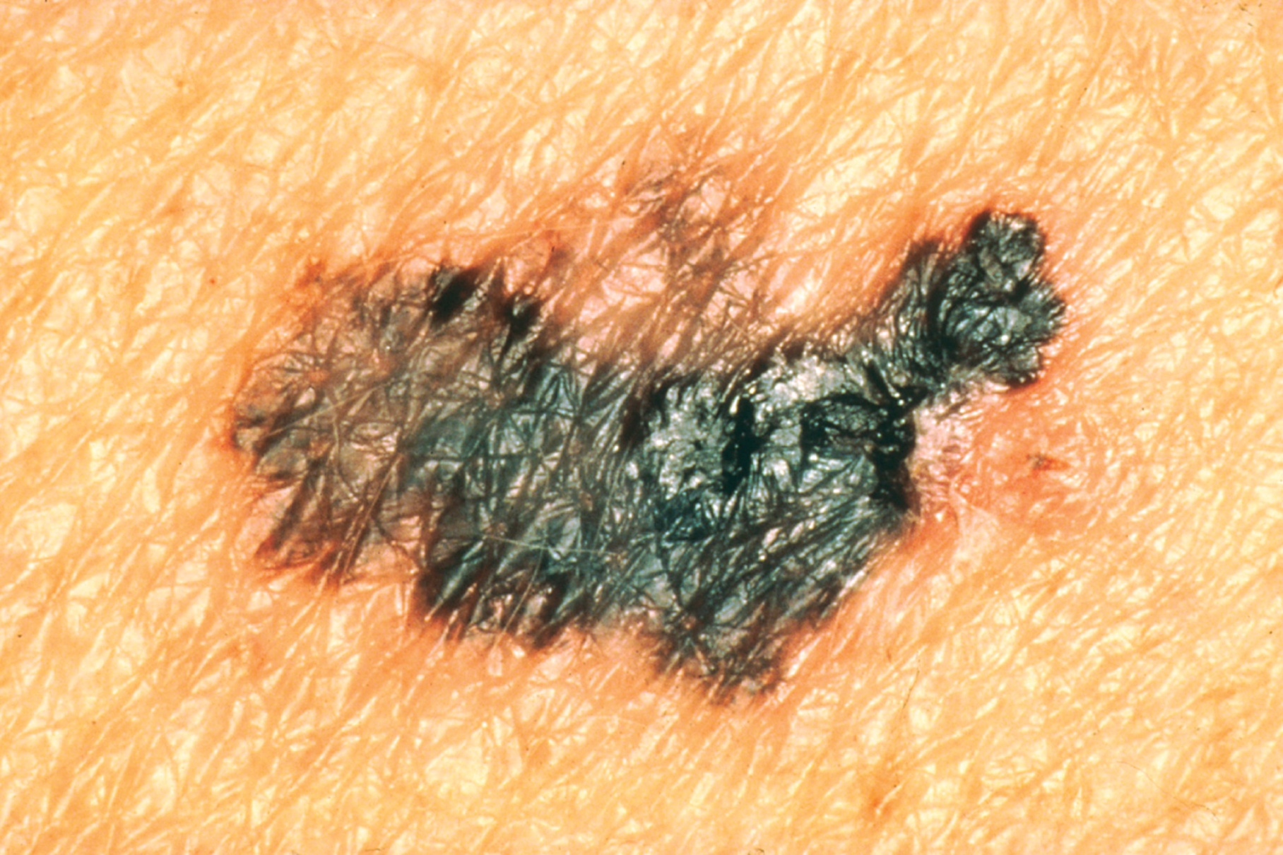
Malignant Melanoma
Notes:
Originates in the melanocytes of the skin
Develop when the cells do not respond to the normal control mechanisms of cellular growth
The primary tumor begins in the skin
Once it becomes invasive, it may progress beyond the site of origin to the regional lymph nodes or travel to other organ systems in the body
Usually diagnosed by using the ABCDE rule
A–Asymmetry - The mole does not have two halves that match each other
B–Border - The border is ragged, notched, or blurred together
C–Color - Color is uneven; shades of black, brown, or tan are present; there may be areas of white, red, or blue present
Diameter - There may be a change in size, and the mole is typically greater than 6 mm in diameter
E–Elevation - The mole sits above the surrounding tissue
Change in size
Change in shape
Change in color
Inflammation
Crusting and bleeding
Sensory change
Diameter greater than 7 mm (0.28 in.)

Slide 27
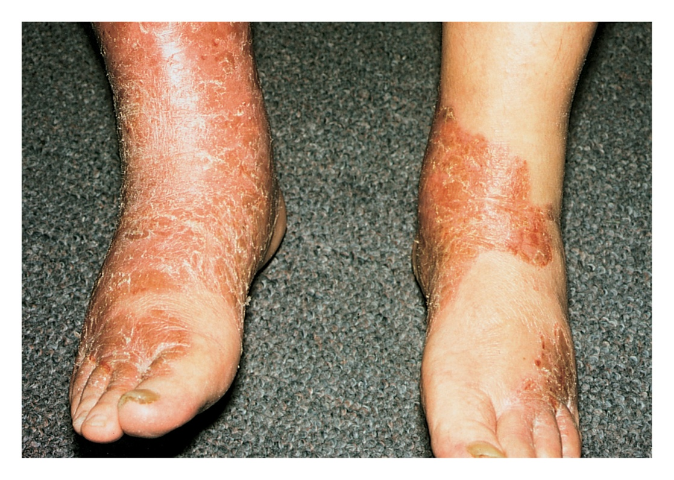
Psoriasis
Affects an estimated 7.5 million Americans
Most commonly between ages 30-50
Condition has genetic and autoimmune characteristics
Thought to be caused by a buildup of dead skin cells
Courtesy of Jason L. Smith, M.D.
Notes:
27
Episodes of redness, itching, and thick dry scales on the skin
Onset can be gradual or abrupt
Flare ups have been attributed to infections, obesity, lack of sunlight as well as sunburn, stress, poor health, and cold climate
When the case is severe and widespread, large quantities of fluid can be lost, causing dehydration and severe secondary infections that can be serious
Analgesics, sedation, intravenous fluids, retinoids and antibiotics
Mild cases are treated at home with topical medications such as prescription or nonprescription dandruff shampoos, cortisone or other corticosteroids, and antifungal medications
Severe lesions may require hospitalization for proper treatment

Slide 28
Pathology of the Skin
rubella | contagious viral infection; German measles
scabies | mite infestation
sebaceous cyst | sebum filled sac forms around sebaceous gland
squamous cell carcinoma (SCC) | cancer of epidermis layer; may invade deeper tissue and metastasize
strawberry hemangioma | congenital collection of dilated blood vessels; birthmark

Slide 29
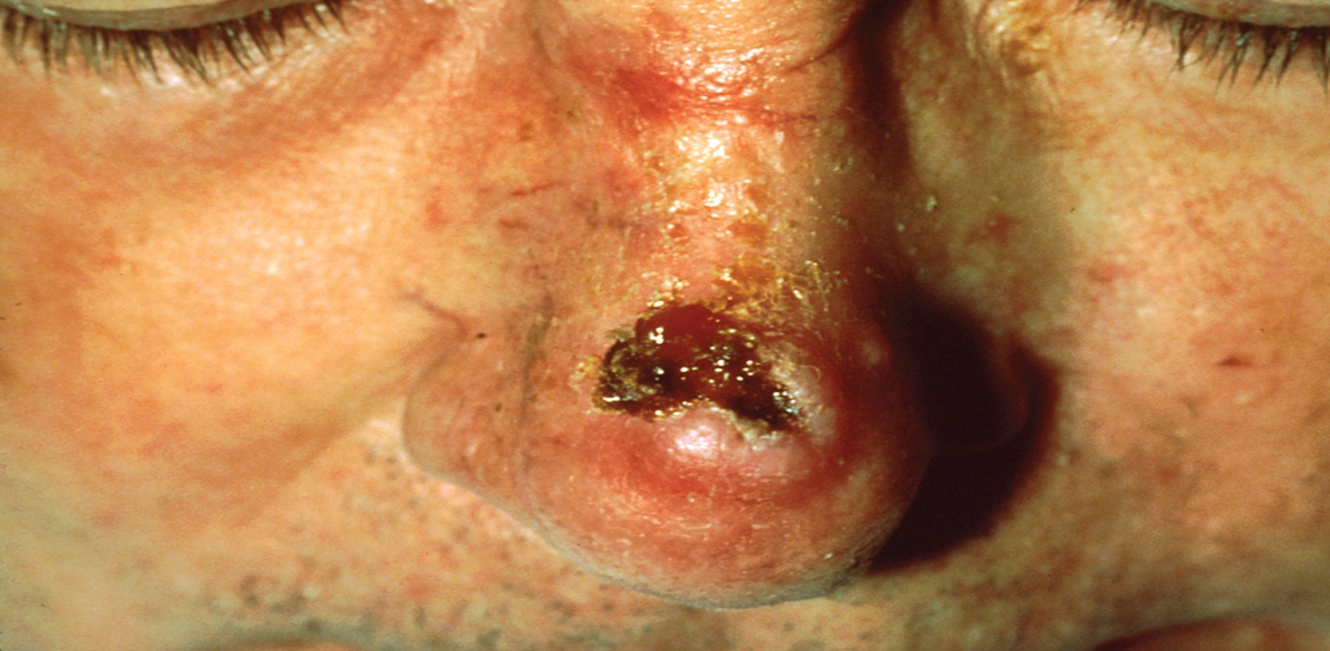
Squamous Cell Carcinoma
Notes:
Indicators:
Changes to an existing wart, mole, or other skin lesion
Development of a new growth that ulcerates and does not heal well
Risk factors include:
Genetic predisposition
Chemical pollution
Overexposure to X-rays or other forms of radiation
Exposure to arsenic
Any skin lesion, growth, or bump that is small, firm, reddened, nodular, coned, or flat in shape
If the surface is scaly or crusted and the lesion or growth is located on the face, ears, neck, hands, or arms
Occasionally the growth may occur on the lip, mouth, tongue, or genitals

Slide 30
Pathology of the Skin
systemic lupus erythematosus (SLE) | chronic disease of connective tissue; injures skin, joints, & kidneys; produces red, scaly butterfly rash across face
tinea | fungal infection; itching & scaling lesions
tinea capitis | fungal infection on scalp; ringworm
tinea pedis | fungal infection of foot; athlete’s foot
varicella | contagious viral infection; chickenpox
verruca | warts; benign growth caused by virus

Slide 31
Pathology of the Skin
vitiligo | disappearance of pigment from skin in patches; causes milk-white lesions
wet gangrene | area of gangrene with secondary bacterial infection and pus

Slide 32
Pathology of the Hair
alopecia | absence or loss of hair; baldness
carbuncle | furuncle involving several hair follicles
furuncle | bacterial infection of hair follicle; redness, pain, and swelling; a boil
trichomycosis | fungal infection of hair

Slide 33
Alopecia
The condition of baldness or loss of hair.
The most common form is male-pattern baldness, also known as androgenic alopecia.
Women may also experience alopecia.
Notes:
33
Affects about 1 in 100 people, mostly teenagers and young adults
Causes patches of baldness that are about the size of a large coin
Usually appear on the scalp but can occur anywhere on the body, including the beard, eyebrows, and eyelashes
Usually no other symptoms
Hereditary
Called male-pattern baldness because it tends to follow a set pattern
The first stage is usually a receding hairline
Followed by thinning of the hair on the crown and temples
When these two areas meet in the middle, there is a horseshoe shape of hair around the back and sides of the head
Eventually the person may be completely bald
Drugs that treat both male and female baldness
These do not work for everyone and the effects are typically not long lasting
Lotions that can be rubbed on the scalp
These do not work for everyone, nor do they have long-lasting effects.
Shampoos and formulas are available for improving circulation to the scalp

Slide 34
Pediculosis
An infestation of the eggs, larvae, or adult lice.
Forms of pediculosis include: Pediculus humanus capitis (head louse), Pediculus humanus corporis (body louse), and Pthirus pubis (pubic louse).
Notes:
34
The most common symptom among all forms of lice is itching
Head lice tends to cause itching around the back of the head or around the ears
Itching surrounding the genitals is an indicator of pubic lice
Body lice tend to travel to the body to feed on skin and then return to clothing

Slide 35
Pathology of the Nails
onychia | infected nail bed
onychomycosis | fungal infection of nail
onychophagia | nail biting
paronychia | infection of skin fold around nail

Slide 36
Medical Specialties
Dermatology (DERM, derm) | Branch of medicine involving diagnosis and treatment of conditions and diseases of the integumentary system. Physician is a dermatologist.
Plastic surgery | Surgical specialty involved in repair, reconstruction, or improvement of body structures such as the skin that are damaged, missing, or misshapen. Physician is a plastic surgeon.

Slide 37
Clinical Laboratory Tests
culture & sensitivity (C&S) | grows bacteria removed from infected area to identify infecting bacteria; then determines sensitivity to various antibiotics

Slide 38
Biopsy Procedures
biopsy (BX, bx) | removal of piece of tissue to examine under a microscope; aids in diagnosis
exfoliative cytology | scraping cells from tissue to examine under microscope
frozen section (FS) | thin piece of tissue is cut from frozen specimen for rapid examination under microscope
fungal scrapings | scrapings from lesion is cultured and then examined under microscope

Slide 39
Skin Grafting
skin graft (SG) | transfer of skin from normal area to cover another site
allograft | skin graft from one person to another; also called homograft
autograft | skin graft from a person’s own body
xenograft | skin graft from an animal of another species; usually a pig; also called heterograft
dermatome | instrument for cutting skin or for producing thin transplants of skin
dermatoplasty | skin grafting

Slide 40
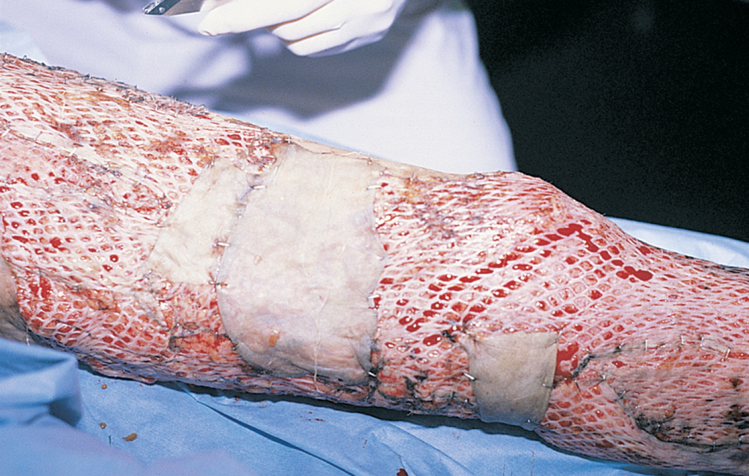
A Freshly Applied Autograft

Slide 41
Surgical Procedures
cauterization | destruction of tissue by using chemicals, electricity, heat, or freezing
cryosurgery | use of extreme cold to freeze and destroy tissue
curettage | removal of superficial skin lesion with a scraper (curette)
debridement | removal of foreign material & dead or damaged tissue from wound
electrocautery | using an electric current to destroy tissue
incision & drainage (I&D) | making an incision to drain material such as pus
onychectomy | surgical removal of a nail

Slide 42
Plastic Surgery
chemabrasion | abrasions using chemicals; chemical peel
dermabrasion | abrasion using wire brushes or sandpaper; removes scars, tattoos
laser therapy | removal of lesions using a laser beam
liposuction | removal of fat beneath skin by means of suction
rhytidectomy | surgical removal of excess skin to eliminate wrinkles; face lift

Slide 43
Integumentary Pharmacology
anesthetic | deaden pain | Xylocaine, Novocain
antibiotic | kill bacteria | Neosporin
antifungal | kill fungi | Monistat, Lotrimin
antiparasitic | kill mites or lice | Kwell, Nix

Slide 44
Integumentary Pharmacology
antipruritic | reduce severe itching | Benadryl, Caladryl
antiseptic | kill bacteria | isopropyl alcohol, hydrogen peroxide
anti-viral | treat herpes simplex infection | Valtrex, Famvir, Zovirax
corticosteroid cream | powerful anti-inflammatory | Cortaid; Kenalog

Slide 45
Integumentary Abbreviations
BCC | basal cell carcinoma
BX, bx | biopsy
C&S | culture and sensitivity
decub | decubitus ulcer
Derm, derm | dermatology
FS | frozen section

Slide 46
Integumentary Abbreviations
HSV | herpes simplex virus
I&D | incision and drainage
ID | intradermal
MM | malignant melanoma
SCC | squamous cell carcinoma
SG | skin graft

Slide 47
Integumentary Abbreviations
SLE | systemic lupus erythematosus
STSG | split thickness skin graft
subcu, SC, sc, subq | subcutaneous
UV | ultraviolet

Slide 48
Discussion
The Integumentary System

Slide 49
Activity
Charting Transcription and Case Study

Slide 50
Skill and Drill Activity
The Integumentary System

Slide 51
The integumentary system is commonly referred to as the
Heart
Skin
Lungs
Stomach

Slide 52
The integumentary system is commonly referred to as the
Heart
Skin
Lungs
Stomach

Slide 53
The largest organ of the human body is
Skin
Heart
Lungs
Stomach

Slide 54
The largest organ of the human body is
Skin
Heart
Lungs
Stomach

Slide 55
Functions of the integumentary system include
Protection
Regulation
Sensory reception
All of the above

Slide 56
Functions of the integumentary system include
Protection
Regulation
Sensory reception
All of the above

Slide 57
The skin is vital to body temperature regulation
True
False

Slide 58
The skin is vital to body temperature regulation
True
False

Slide 59
The layers of the skin include
Dermis
Epidermis
Subcutaneous
All of the above

Slide 60
The layers of the skin include
Dermis
Epidermis
Subcutaneous
All of the above

Slide 61
Sebaceous glands secrete
Perspiration
Oil
Perspiration and oil
None of the above

Slide 62
Sebaceous glands secrete
Perspiration
Oil
Perspiration and oil
None of the above

Slide 63
Sudoriferous glands secrete
Perspiration
Oil
Perspiration and oil
None of the above

Slide 64
Sudoriferous glands secrete
Perspiration
Oil
Perspiration and oil
None of the above

Slide 65
The most common skin cancers include
Basal cell carcinoma
Squamous cell carcinoma
Malignant melanoma
All of the above

Slide 66
The most common skin cancers include
Basal cell carcinoma
Squamous cell carcinoma
Malignant melanoma
All of the above

Slide 67
The majority of skin cancers are either basal cell or squamous cell carcinomas
True
False

Slide 68
The majority of skin cancers are either basal cell or squamous cell carcinomas
True
False

Slide 69
Squamous cell carcinoma is not a malignant tumor that affects the middle layer of the skin
True
False

Slide 70
Squamous cell carcinoma is not a malignant tumor that affects the middle layer of the skin
True
False

Slide 71
Skin growths should be observed for
Change in size
Change in shape
Change in color
All of the above

Slide 72
Skin growths should be observed for
Change in size
Change in shape
Change in color
All of the above

Slide 73
Acne vulgaris (acne) is a common skin condition that occurs when oil and dead skin cells clog the skin’s pores
True
False

Slide 74
Acne vulgaris (acne) is a common skin condition that occurs when oil and dead skin cells clog the skin’s pores
True
False

Slide 75
Alopecia is baldness or loss of hair
True
False

Slide 76
Alopecia is baldness or loss of hair
True
False

Slide 77
Contact dermatitis is not an allergic reaction of the skin caused by irritating substances
True
False

Slide 78
Contact dermatitis is not an allergic reaction of the skin caused by irritating substances
True
False

Slide 79
Causes of contact dermatitis often include
Exposure to poison ivy or poison oak
Nickel
Lotions and detergents
Any of the above

Slide 80
Causes of contact dermatitis often include
Exposure to poison ivy or poison oak
Nickel
Lotions and detergents
Any of the above

Slide 81
Small blisters on the skin are known as
Callus
Corn
Decubiteous ulcer
Vesicles

Slide 82
Small blisters on the skin are known as
Callus
Corn
Decubiteous ulcer
Vesicles

Slide 83
An area of thickened skin that does not have an identifiable border
Callus
Corn
Decubiteous ulcer
Vesicles

Slide 84
An area of thickened skin that does not have an identifiable border
Callus
Corn
Decubiteous ulcer
Vesicles

Slide 85
A growth, typically on the foot, that has a distinct border with various textures
Callus
Corn
Decubiteous ulcer
Vesicles

Slide 86
A growth, typically on the foot, that has a distinct border with various textures
Callus
Corn
Decubiteous ulcer
Vesicles

Slide 87
Called a pressure sore or bedsore, is an area of skin and tissue that breaks down
Callus
Corn
Decubiteous ulcer
Vesicles

Slide 88
Called a pressure sore or bedsore, is an area of skin and tissue that breaks down
Callus
Corn
Decubiteous ulcer
Vesicles

Slide 89
General signs and symptoms of herpes simplex include the following
Mouth sores
A burning or tingling sensation followed by the development of genital lesions
Blisters or ulcers on the mouth, lips, gums, or genitalia
All of the above

Slide 90
General signs and symptoms of herpes simplex include the following
Mouth sores
A burning or tingling sensation followed by the development of genital lesions
Blisters or ulcers on the mouth, lips, gums, or genitalia
All of the above

Slide 91
Summary
Topics Covered

