Slide 1
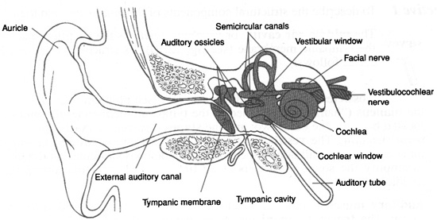
Chapter 6; the Ear

Slide 2
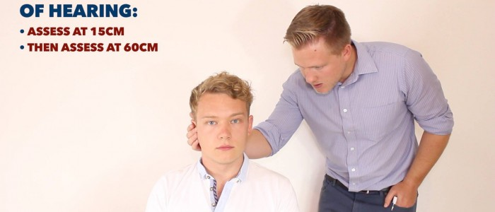
Gross or whispered test
Ask pt. to repeat what you Whisper
from 1 to 2 feet away

Slide 3
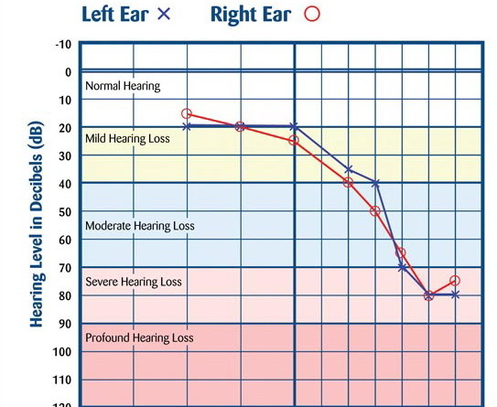
audiometry
Gives numbers to the measurement of hearing

Slide 4
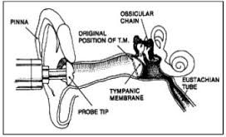
tympanometry
Tests how the tympanic membrane moves
If it does not move there may be fluid in the middle ear
May be Otitis Media

Slide 5
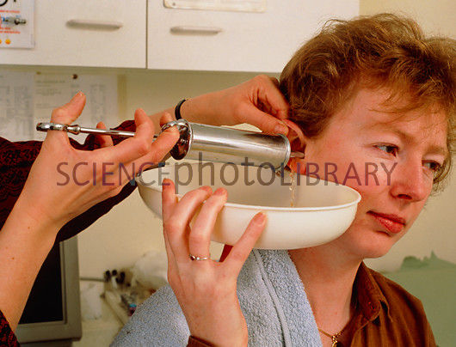
3 reasons for ear irrigation
To wash the ear to remove cerumen (ear wax)
To wash before putting in medication
To add heat.

Slide 6
3 reasons for performing an ear instillation.
Soften ear wax (cerumen)
Fight infection
Relieve pain

Slide 7
how impacted cerumen is removed
Straighten the ear canal
Point the syringe up
Wash

Slide 8
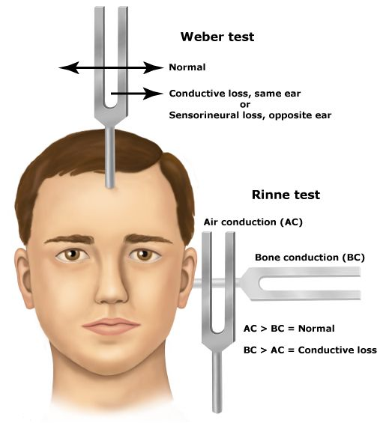
tuning fork

