Slide 1
Unit 2
The Urinary System

Slide 2
Class Overview

Slide 3
Lecture
The Urinary System

Slide 4
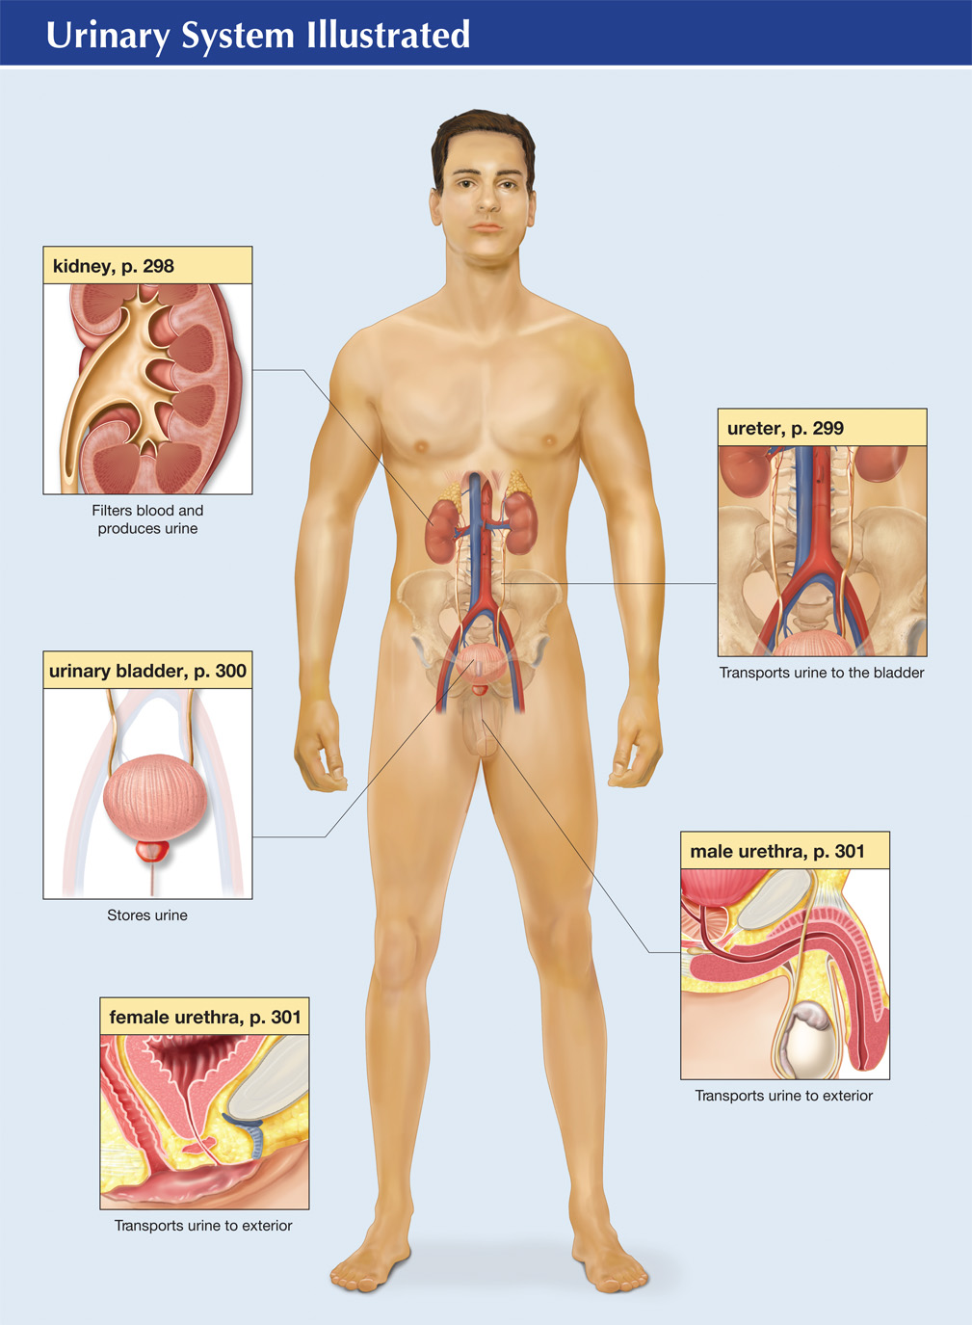
The Urinary System
Urinary System Illustrated
Notes:
Kidneys excrete waste products.
Waste contains mostly water as well as salts and nitrogen compounds
Drains from the kidneys through the ureters to the bladder
Is stored in the bladder
Bladder empties during urination

Slide 5
Structures of the Urinary System
Notes:
5
Urine consists of water, hydrogen ions, and uric acid
Adult passes about 1,000–1,500 mL of urine daily
Characteristics of normal urine
Clear versus cloudy
Two muscular tubes that carry urine from the kidneys down to the urinary bladder
Composed of three layers
Inner mucous membrane
Middle layer of smooth muscle
Outer fibrous layer
About 28–34 cm (10–12 in.) long and less than 1 mm to 1 cm (¼ inch) in diameter
Straw colored
Specific gravity of 1.003–1.030
Slightly acidic pH of about 6
Specifications of normal urine vary with ageConsists of four layers
Inner layer of epithelium
Layer of smooth muscle
Layer of longitudinal muscle
Outer fibrous layer
Stretches to hold urine
Urge to urinate typically occurs when the adult bladder holds 300–350 mL of urine
Empties through the urethra and the urinary meatus

Slide 6
External Structure of the Kidneys
Hilum
Entrance for renal arteries, nerves, and lymphatic vessels
Renal Pelvis
Collection point for urine before it is transported to the ureter
Notes:
6
Bean-shaped organs
Located at the posterior region of the abdominal cavity between the 12th thoracic and 3rd lumbar vertebrae
Encased in three capsules for protection
True capsule
Perirenal fat
Renal fascia

Slide 7
Internal Structure of the Kidneys
Cortex
Outer layer
Contains arteries, veins, convoluted tubules, and glomerular capsules (part of the nephron)
Medulla
Inner layer
Renal pyramids contain collecting tubules
Notes:
7
Cortex
Outer portion
Medulla
Inner portion
Pyramids
Triangular shaped structures in medulla
Papilla
Tip of each renal pyramid

Slide 8
The Nephron
Nephron consists of:
Glomerulus
Bowman’s Capsule
Renal tubule
Proximal convoluted tubule
Loop of Henle
Distal convoluted tubule
Collecting tubule
Notes:
8
Functional unit of the kidney
Each kidney contains more than one million nephrons

Slide 9
Ureters
Urine drains from renal pelvis into ureters
Extend from renal pelvis to urinary bladder
Lined with mucous membranes

Slide 10
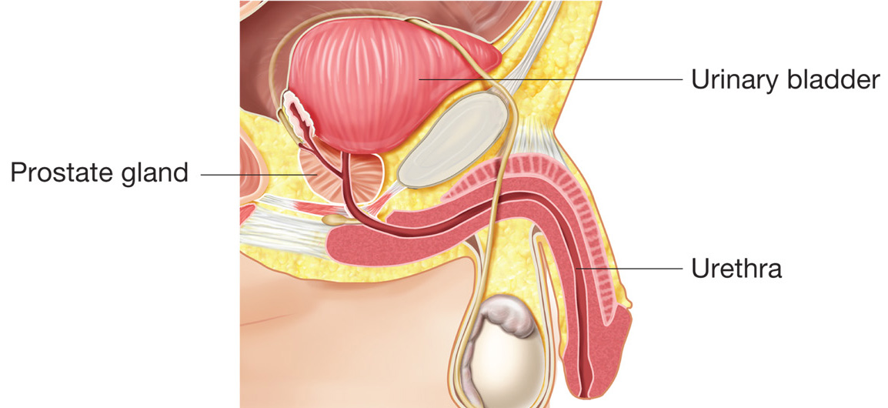
The Male Urethra
Notes:
Musculomembranous tube extending from the bladder to the urinary meatus, the external opening of the urinary system
In males, the urethra is approximately 20 cm long and transports both urine and semen
The male urethra has three sections:
Prostatic
Membranous
Penile

Slide 11
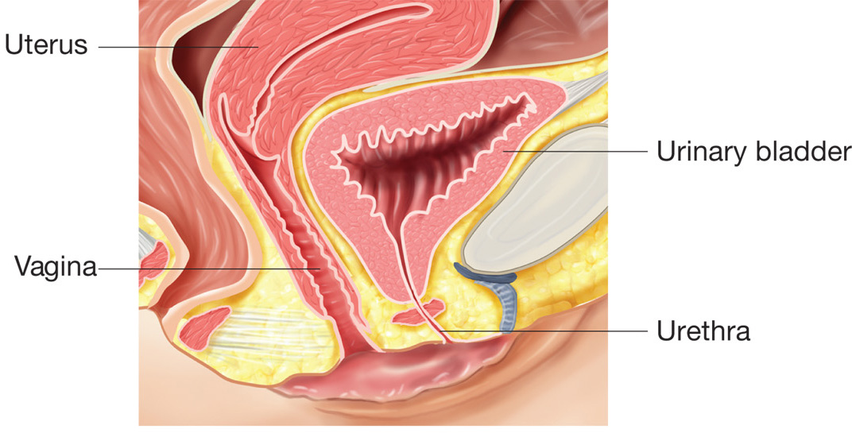
The Female Urethra
Notes:
In females, the urethra is approximately 3 cm long and transports only urine
Its external opening is situated between the clitoris and the opening of the vagina

Slide 12
Renal Tubules
Filtrate flows through renal tubules to complete urine production process

Slide 13
Kidney Pathology
acute tubular necrosis (ATN) | damage to renal tubules due to toxins in the urine; results in oliguria
diabetic nephropathy | damage to glomerular capillaries due to high blood sugar of diabetes mellitus
glomerulonephritis | inflammation of the kidney; more permeable to protein and blood cells
hydronephrosis | distention of renal pelvis due to accumulation of urine in the kidney

Slide 14
Kidney Pathology
nephritis | kidney inflammation
nephrolithiasis | presence of calculi in the kidney; solidification of salts in the urine
nephroma | kidney tumor
nephropathy | general term for presence of kidney disease
nephroptosis | downward displacement of the kidney; floating kidney
nephrotic syndrome (NS) | damage to glomerulus; protein appears in the urine
polycystic kidneys | formation of multiple cysts within the kidney; destroys normal kidney tissue
pyelitis | renal pelvis inflammation

Slide 15
Kidney Pathology
pyelonephritis | inflammation of renal pelvis and kidney; common type of kidney disease
renal cell carcinoma | cancerous tumor of renal tubule cells
renal failure | inability of kidneys to filter wastes; results in uremia
Wilm’s tumor | malignant kidney tumor; most often found in children

Slide 16
Urinary Bladder Pathology
bladder cancer | cancerous tumor arising from cells lining bladder; symptom is hematuria
bladder neck obstruction (BNO) | blockage of bladder outlet; often caused by enlarged prostate gland
cystitis | urinary bladder inflammation
cystocele | protrusion of the urinary bladder into wall of vagina

Slide 17
Urinary Bladder Pathology
interstitial cystitis | inflammation and irritation of bladder
neurogenic bladder | loss of nervous control; leads to retention
urinary tract infection (UTI) | infection of any organ of urinary system; usually from bacteria; begins with cystitis and may ascend into ureters and kidneys

Slide 18
Medical Specialties
nephrology | Branch of medicine involved in diagnosis and treatment of diseases and disorders of the kidney. Physician is a nephrologist.
urology | Branch of medicine involved in diagnosis and treatment of diseases and disorders of the urinary system (and male reproductive system). Physician is a urologist.

Slide 19
Clinical Laboratory Tests
blood urea nitrogen (BUN) | blood test to evaluate kidney function by measuring level of nitrogenous waste (urea) in the bloodstream
clean catch specimen (CC) | urine sample obtained after cleaning off the urinary meatus and collecting sample in midstream
creatinine clearance | test of kidney function; amount of creatinine in bloodstream is compared to amount in the urine

Slide 20
Clinical Laboratory Tests
urinalysis (U/A, UA) | physical, chemical, and microscopic examination of urine
urine culture & sensitivity (C&S) | test for bacterial infection; attempt to grow bacteria on a culture medium in order to identify it; then determine which antibiotics it is sensitive to
urinometer | instrument to measure specific gravity of urine

Slide 21
Diagnostic Imaging
cystogram | X-ray record of the bladder
cystography | contrast dye is placed in bladder and then X-ray is taken; outlines bladder
excretory urography (EU) | dye is injected into bloodstream; X-ray traces the dye as it moves through organs of the urinary system
intravenous pyelography (IVP) | injecting a dye into a vein and then taking an X-ray to outline the renal pelvis

Slide 22
Diagnostic Imaging
kidneys, ureters, bladder (KUB) | abdominal X-ray showing the kidneys, ureters, and bladder
nephrogram | X-ray record of the kidney
pyelogram | X-ray record of the renal pelvis
retrograde pyelogram (RP) | dye is inserted through the urethra to outline the bladder, ureters, and renal pelvis
voiding cystourethrography (VCUG) | dye is placed in the bladder; X-ray taken to visualize the urethra while patient is voiding

Slide 23
Endoscopic Procedures
cystoscope | instrument used to visually examine urinary bladder
cystoscopy (cysto) | visual examination of the urinary bladder using a cystoscope
urethroscope | instrument used to visually examine urethra

Slide 24
Medical Treatments
catheter | flexible tube inserted into the body; commonly through urethra into bladder
catheterization (cath) | insertion of a tube through urethra and into the urinary bladder
extracorporeal shockwave lithotripsy (ESWL) | use of ultrasound waves to break up renal calculi
hemodialysis (HD) | use of artificial kidney machine to filter the blood
peritoneal dialysis | removes wastes using chemically balanced solutions placed into peritoneal cavity

Slide 25
Dialysis Machine
Notes:
25
Method for removing toxins from the blood and maintaining water balance when the kidneys cannot
Hemodialysis
Shunts blood to machines that filter the blood and returns it to the body
Done in dialysis center 3 times weekly
Peritoneal Dialysis
Dialysis fluid solution is instilled in stomach
Membranes in the abdomen filter solution
Solution is removed
Can be done at home or in other setting

Slide 26
Surgical Treatments
cystectomy | surgical removal of the bladder
cystopexy | surgical fixation of the bladder
cystoplasty | surgical repair of the bladder
cystostomy | create a new opening into the bladder
cystotomy | cutting into the bladder
lithotomy | cutting into (to remove) a stone
lithotripsy | crushing a stone in the bladder or urethra
meatotomy | incision into the meatus

Slide 27
Lithotripsy and Extracorporeal Shockwave Therapy
Notes:
27

Slide 28
Surgical Treatments
nephrectomy | surgical removal of a kidney
nephrolithotomy | incision to directly remove stones from the kidney
nephropexy | surgical fixation of a kidney
nephrostomy | create a new opening into a kidney
nephrotomy | cutting into a kidney
pyeloplasty | surgical repair of the renal pelvis
renal transplant | surgical placement of a donor kidney

Slide 29
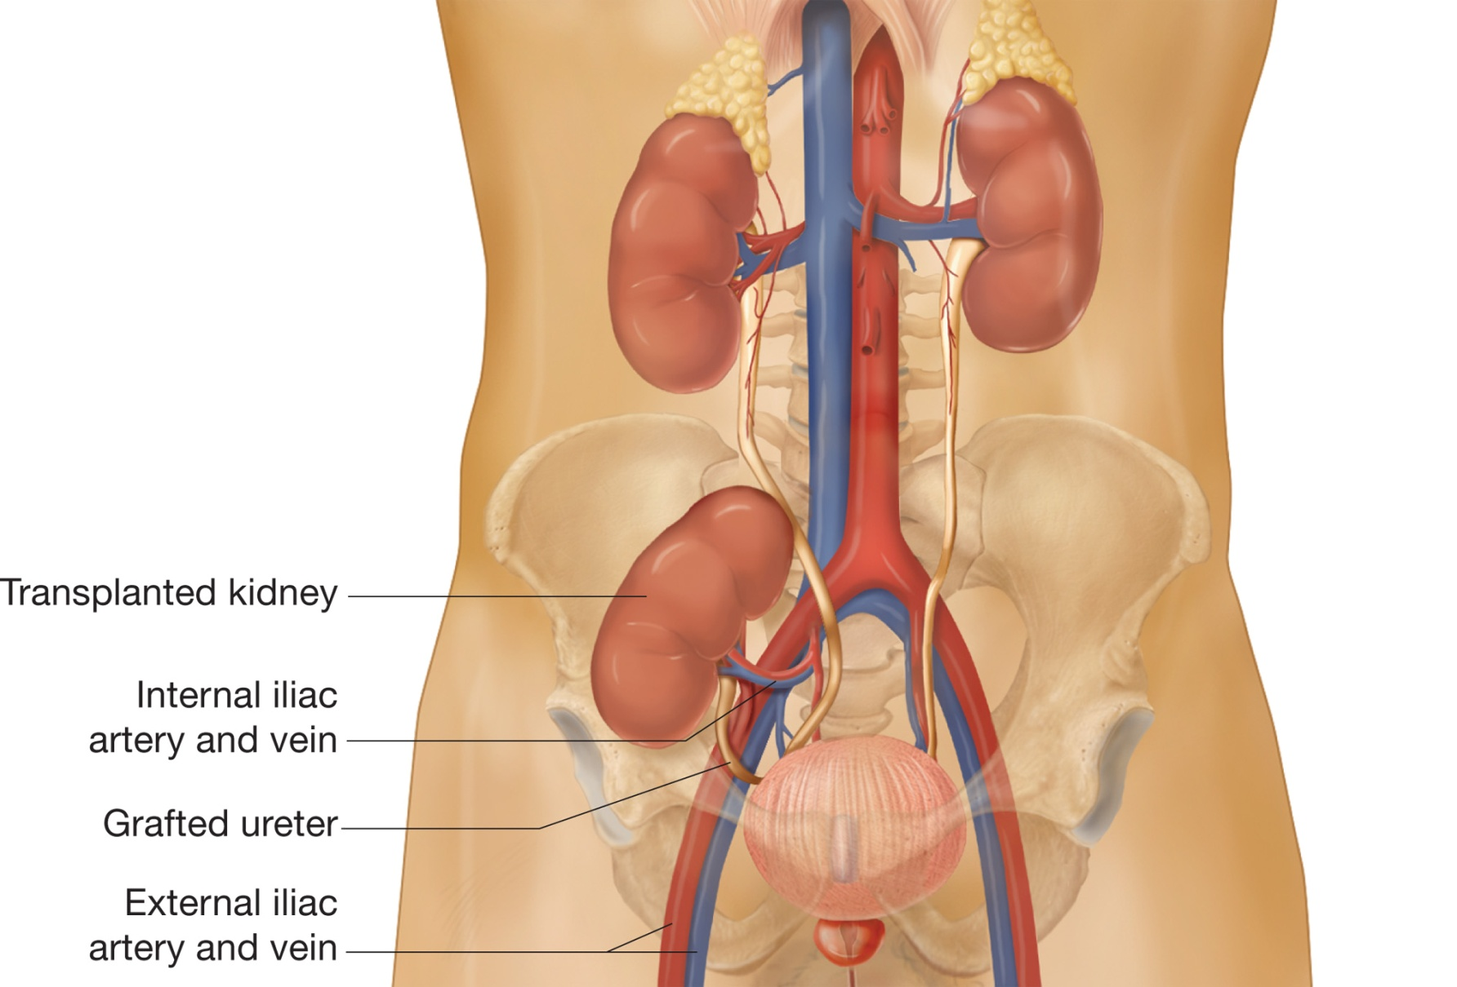
Illustration of a Transplanted Kidney
Notes:
Donor kidney is inserted into the patient’s body
Blood vessels and ureters are attached to the patient’s already existing structures
Recipients must take antirejection drugs for the rest of their lives

Slide 30
Urinary System Pharmacology
antibiotic | treats bacterial infections | Cipro, Macrobid
antispasmodic | prevent or reduce bladder muscle spasms | Ditropan, Prostigmine
diuretics | increases volume of urine | Lasix, Aldactone

Slide 31
Urinary System Abbreviations
AGN | acute glomerulonephritis
ARF | acute renal failure
ATN | acute tubular necrosis
BNO | bladder neck obstruction
BUN | blood urea nitrogen
cath | catheterization

Slide 32
Urinary System Abbreviations
Cl– | chloride
CRF | chronic renal failure
C&S | culture and sensitivity
CAPD | continuous ambulatory peritoneal dialysis
CC | clean catch urine specimen
cysto | cystoscopy
ESRD | end-stage renal disease

Slide 33
Urinary System Abbreviations
ESWL | extracorporeal shockwave lithotripsy
EU | excretory urography
GU | genitourinary
HCO₃– | bicarbonate
HD | hemodialysis
H₂O | water
I&O | input and output

Slide 34
Urinary System Abbreviations
IPD | intermittent peritoneal dialysis
IVP | intravenous pyelogram
K⁺ | potassium
KUB | kidney, ureter, bladder
mL | milliliter
Na⁺ | sodium
NS | nephrotic syndrome

Slide 35
Urinary System Abbreviations
pH | acidity or alkalinity
RP | retrograde pyelogram
SG, sp.gr. | specific gravity
U/A, UA | urinalysis
UC | urine culture
UTI | urinary tract infection
VCUG | voiding cystourethrography

Slide 36
Discussion
The Urinary System

Slide 37
Activity
Charting Transcription and Case Study

Slide 38
Activity
Certification Exam

Slide 39
Skill and Drill Activity
The Urinary System

Slide 40
The urinary system, also called the genitourinary system
True
False

Slide 41
The urinary system, also called the genitourinary system
True
False

Slide 42
Urine is a transparent yellow fluid containing
Unwanted wastes
Excess water
Salts and nitrogen compounds
All of the above

Slide 43
Urine is a transparent yellow fluid containing
Unwanted wastes
Excess water
Salts and nitrogen compounds
All of the above

Slide 44
The primary organs of the system are the ureters, which continuously filter substances from the blood and produce urine
True
False

Slide 45
The primary organs of the system are the ureters, which continuously filter substances from the blood and produce urine
True
False

Slide 46
The structures of the urinary system include
Kidneys
Bladder
Ureters
All of the above

Slide 47
The structures of the urinary system include
Kidneys
Bladder
Ureters
All of the above

Slide 48
Tube like structures that transport the urine from the kidneys to the bladder
Kidneys
Ureters
Bladder
Urethra

Slide 49
Tube like structures that transport the urine from the kidneys to the bladder
Kidneys
Ureters
Bladder
Urethra

Slide 50
The muscular sac that stores the urine for elimination
Kidneys
Ureters
Bladder
Urethra

Slide 51
The muscular sac that stores the urine for elimination
Kidneys
Ureters
Bladder
Urethra

Slide 52
The tube like structure that connects the bladder to the outside of the body
Kidneys
Ureters
Bladder
Urethra

Slide 53
The tube like structure that connects the bladder to the outside of the body
Kidneys
Ureters
Bladder
Urethra

Slide 54
The bean shaped organs that filter waste and produce urine
Kidneys
Ureters
Bladder
Urethra

Slide 55
The bean shaped organs that filter waste and produce urine
Kidneys
Ureters
Bladder
Urethra

Slide 56
Nephrons are the functional units of the kidney
True
False

Slide 57
Nephrons are the functional units of the kidney
True
False

Slide 58
The formation of urine can be divided into
Filtration
Reabsorption
Tubular secretion
All of the above

Slide 59
The formation of urine can be divided into
Filtration
Reabsorption
Tubular secretion
All of the above

Slide 60
Urine consists of 95 percent water and 5 percent solid substances
True
False

Slide 61
Urine consists of 95 percent water and 5 percent solid substances
True
False

Slide 62
Approximately 1,000 to 1,500 ml of urine is voided daily
True
False

Slide 63
Approximately 1,000 to 1,500 ml of urine is voided daily
True
False

Slide 64
Specific gravity does not measure the kidney’s ability to concentrate or dilute urine in relation to plasma
True
False

Slide 65
Specific gravity does not measure the kidney’s ability to concentrate or dilute urine in relation to plasma
True
False

Slide 66
The condition of no urine production
Anuria
Hematuria
Uremia
Pyuria

Slide 67
The condition of no urine production
Anuria
Hematuria
Uremia
Pyuria

Slide 68
The condition of pus in the urine
Anuria
Hematuria
Uremia
Pyuria

Slide 69
The condition of pus in the urine
Anuria
Hematuria
Uremia
Pyuria

Slide 70
The condition of blood in the urine
Anuria
Hematuria
Uremia
Pyuria

Slide 71
The condition of blood in the urine
Anuria
Hematuria
Uremia
Pyuria

Slide 72
The condition of urine products in the blood
Anuria
Hematuria
Uremia
Pyuria

Slide 73
The condition of urine products in the blood
Anuria
Hematuria
Uremia
Pyuria

Slide 74
Cystitis is an inflammation of the bladder, usually secondary to ascending urinary tract infections
True
False

Slide 75
Cystitis is an inflammation of the bladder, usually secondary to ascending urinary tract infections
True
False

Slide 76
Dysuria may be the only symptom of
Hematuria
Cystitis
Anuria
None of the above

Slide 77
Dysuria may be the only symptom of
Hematuria
Cystitis
Anuria
None of the above

Slide 78
Glomerulonephritis is a kidney disease that prevents the kidneys ability to remove waste and excess fluids
True
False

Slide 79
Glomerulonephritis is a kidney disease that prevents the kidneys ability to remove waste and excess fluids
True
False

Slide 80
Summary
Topics Covered

