Slide 1
Chapter 57 Mental Health

Slide 2
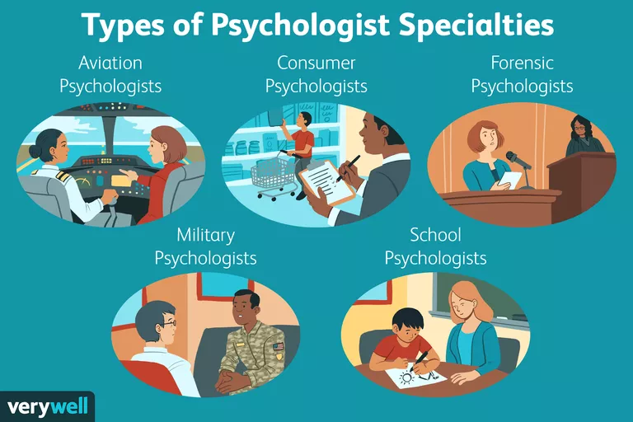
Psychology: study of
Behavior and human
thought process
Psychologist: specialist
trained in analysis,
treatment and research.
Can not write prescription
Psychiatrist: specialist
that deals with diagnosis,
treatment and prevention
May write prescriptions

Slide 3
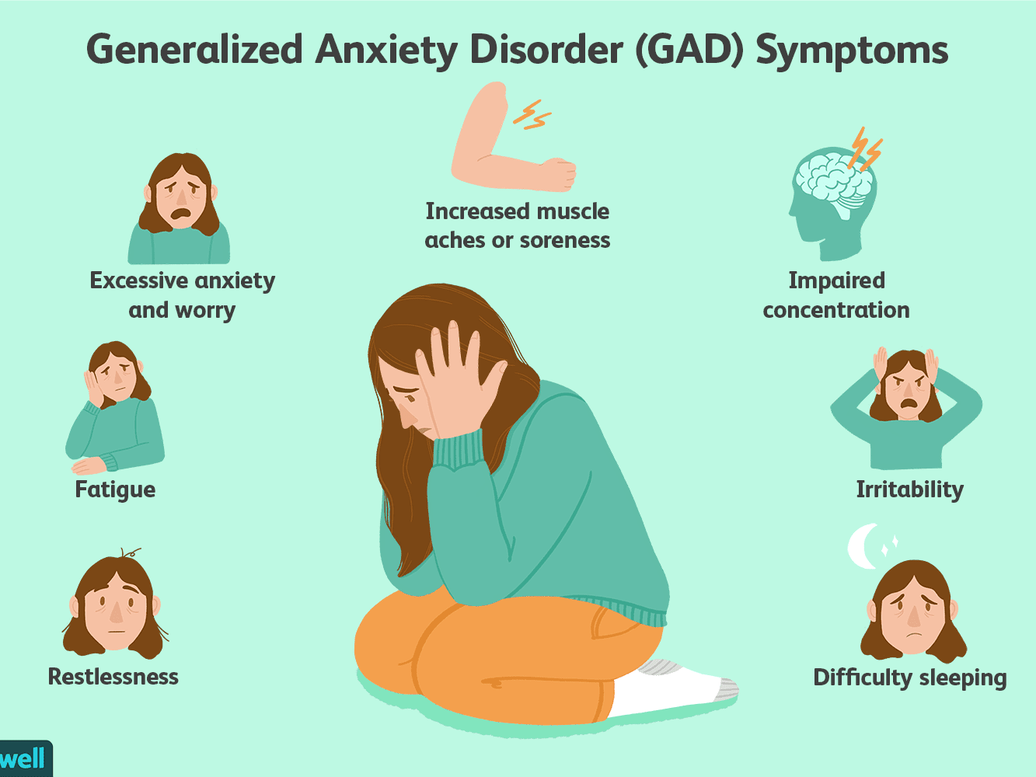
PSYCHOLOGICAL DISORDERS
Anxiety: Emotional disturbances that impair judgement.
Phobias, panic attacks, compulsive rituals
Compulsions: Repetitive acts performed to relieve anxiety.
Delusions: Persistent thoughts

Slide 4
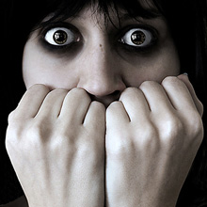
PHOBIAS
Acrophobia-Fear of heights
Agoraphobia-Fear of crowds
Claustrophobia- Fear of closed spaces
Microphobia – Fear of germs
Social Phobia – Fear of being embarrassed or humiliated in front of others
Thanatophobia – Fear of death
Xenophobia – Fear of strangers

Slide 5
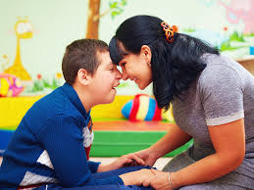
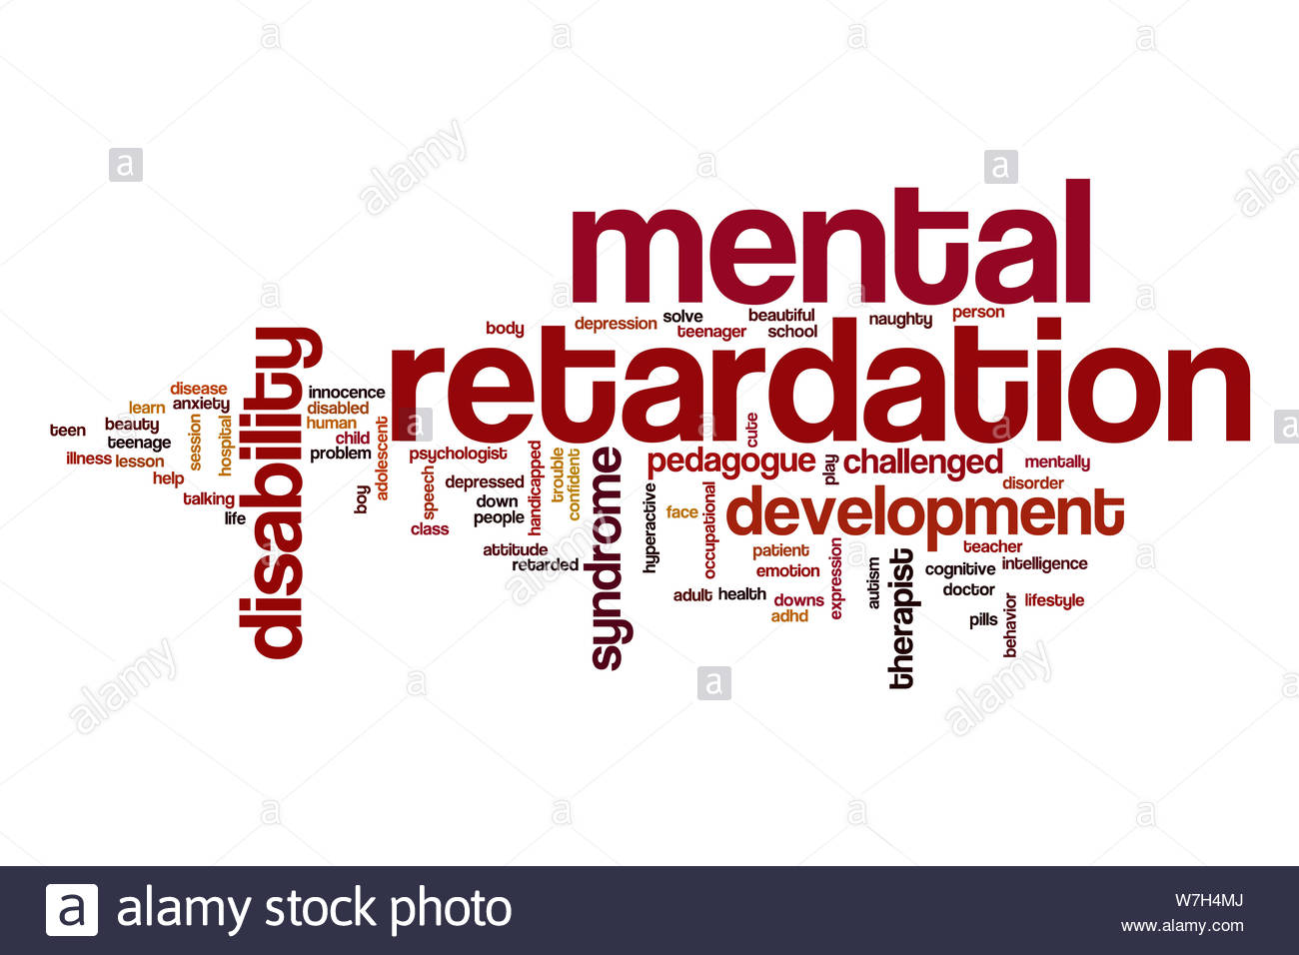
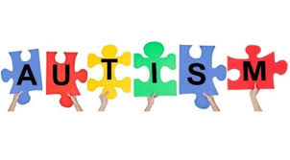
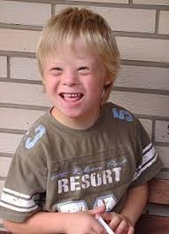
DEVELOPMENTAL DISORDERS
Broad term that includes some individuals who are
profoundly unable to function in the world and those
and those who have relatively high intelligence but
are slow to learn.

Slide 6
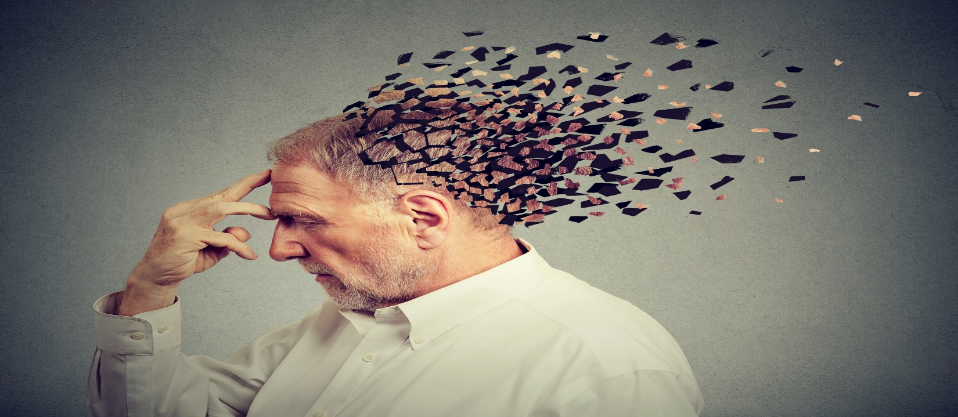
DISSOCIATIVE DISORDERS
Withdraw from reality, separate themselves
. Multiple personality
. Amnesia-forgetting events and places and even
one’s identity.

Slide 7
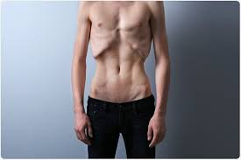
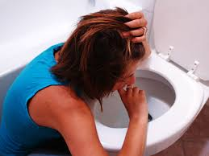
EATING DISORDERS
Anorexia Nervosa : Obsess about weight and food, seeing
themselves as overweight, life-threatening disorder.
Bulimia Nervosa: Overeating followed by purging with
Laxatives or vomiting

Slide 8
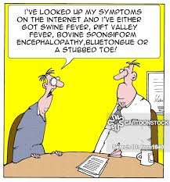
HYPOCHONDRIASIS: Person is preoccupied with fears of contacting, or idea that one has,
a serious disease, based on misinterpretation of one or bodily signs or symptoms.
IMPULSE CONTROL DISORDERS: ADHD(ATTENTION DEFICIT HYPERACTIVITY DISORDER)
Inability to pay attention, hyperactivity, impulsive behaviors
Other impulse control disorders include gambling, stealing, setting fires.

Slide 9
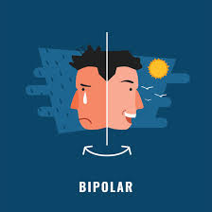
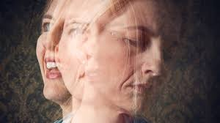
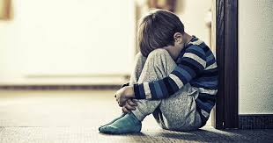
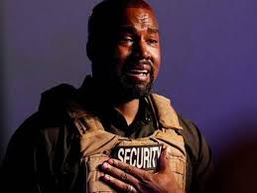
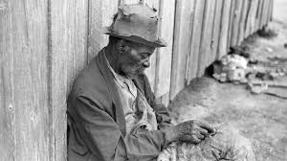
MOOD DISORDERS
BIPOLAR: 2 POLES, MANIA AND DEPRESSION(ORIGINALLY CALLED MANIC DEPRESSIVE)
There are actually stages of bipolar. Mood swings to profound depression.
DEPRESSION: Affects 20 million people in the United States. Symptoms of sadness, lack of
enjoyment in life, suicidal thoughts, difficulty sleeping.

Slide 10
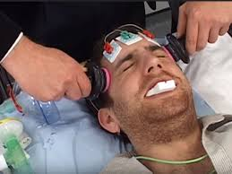
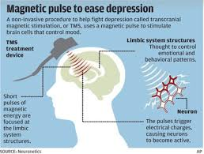
TREATMENTS FOR MENTAL DISORDERS
PSYCHOTHERAPY: Analysis, group therapy, help the patient cope with life.
TRANSCRANIAL MAGNETIC STIMULATION(TMS)-Non-invasive procedure causing
Depolarization or hyperpolarization in the neurons of the brain.
PSYCHOPHARMACOLOGY: Effects of drugs on the mind and brain particularly the use of
drugs in treating disorders.
. Antipsychotic drugs “major” tranquilizers
. Antidepressant drugs alter the patient’s mood by affecting levels of
neurotransmitters in the brain
. Minor tranquilizers anxiety drugs not effective in treating emotional disorders
. Lithium-drug used to calm patient who suffer from bipolar disorder
ELECTROCONVULSIVE THERAPY (ECT): Procedure used for cases of prolonged major
Depression.

Slide 11
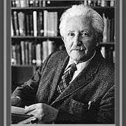
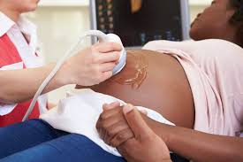
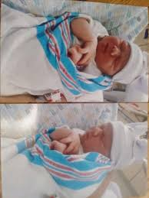
ERIKSON’S DEVELOPMENTAL STAGES OF LIFE
PRENATAL: Conception to Birth
INFANCY: Birth to Toddler(2-3 years), trust and mistrust, sensory skills, caregiver attachment
CHILDHOOD: Ages 3-5 years, cognitive and physical appearance change, at age 6-11 achievement is
very important to them
ADOLESCENCE: age 12-14, late adolescents age 15-19, sexual development, more independence from
their parents, find their identity, role confusion
ADULTHOOD: Challenges of career choice, success, at age 60 and older sometimes the person feels
integrated or despair, physical capacities and relationships change, new meanings are discovered
within family relationships

Slide 12
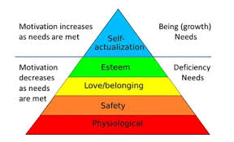

Slide 13
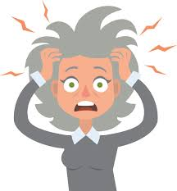
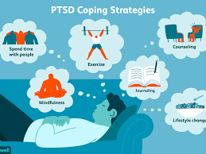
STRESS….
Bodies reaction to the world around it…
Symptoms of stress: Fatigue, exhaustion, lack of interest, depression, cramps, sore muscles,
change in eating habits, boredom, tension, restlessness
…..Depending on the level of stress it can be energizing, motivating or exhausting.
**Motivation; the stimulus that drives us to act.
PTSD: Post traumatic stress disorder, feelings of anxiety, aggression, irritability, tension, guilt,
feeling of detachment from others.
. Physical or sexual assault
. Natural disaster
. Terrorist attack
. Military combat

Slide 14
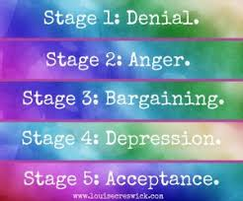
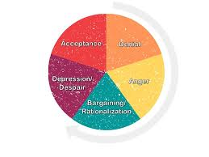
STAGES OF GRIEF…

