Slide 1
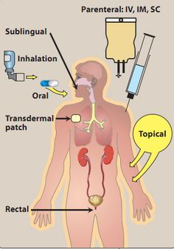
MEDICATION
Chapter 11
January 2017

Slide 2
How many ways to give meds can you name?

Slide 3
Reading the Rx label
Pt. name
Holly Roberts
Medication is
Amoxil
Strength
250 mg
Directions
One by mouth 3 times a day for 10 days

Slide 4
Abbreviations
Cipro
Prevacid 15mg
Lipitor 10 mg
Prozac 20 mg
Tobrex ophthalmic Soln.
One every 12 hours by mouth for 10 days
One daily by mouth
One daily by mouth
One daily by mouth
One drop every 3 hours in the right eye

Slide 5
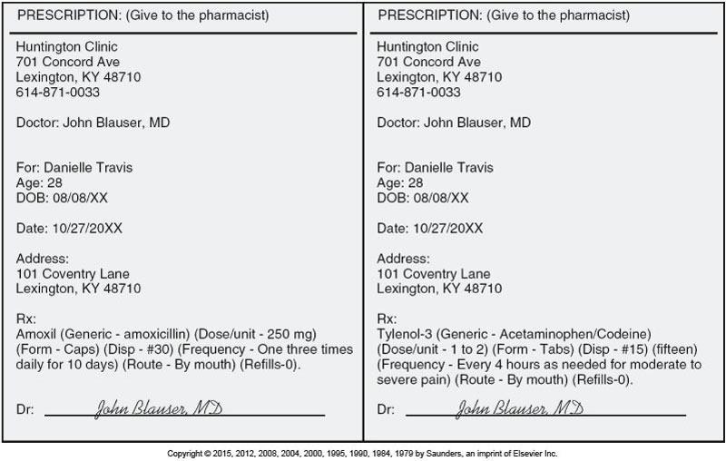
Underline the Seven Rights of Medication
Who (pt.) Danielle Travis
What (meds) Amoxil 250 mg
Where (route) by mouth
When (when given) one tab tid x 10 days
How much (dose) 250 mg
How given (form) or Effect - tablets
Document
Amoxil 250 mg one tab tid x 10 days

Slide 6
Chart notes: Acetaminophen 650 mg po. Pt tolerated medicine well----------L. Brammer, MA

Slide 7
Epi Pen gives Epinephrine for anaphylactic shock

Slide 8
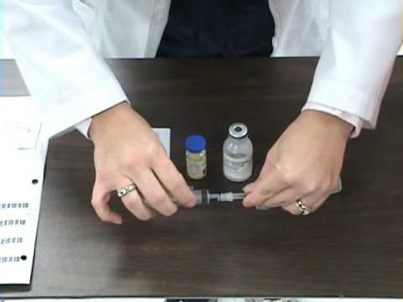
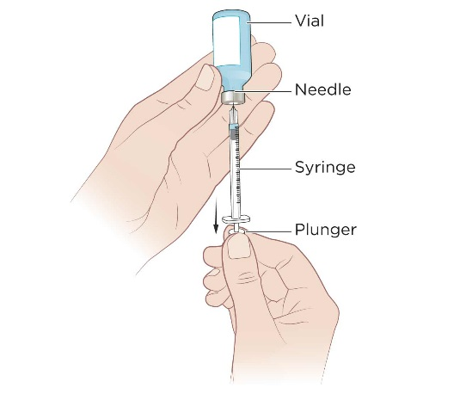
Draw up for a shot

Slide 9
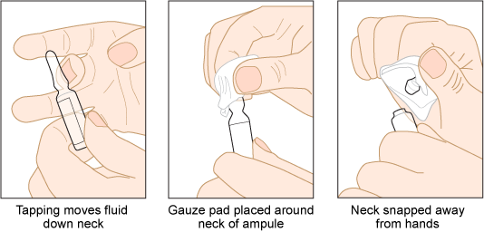
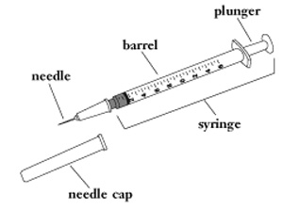
Open a vial away from you using gauze and a filter needle.

Slide 10
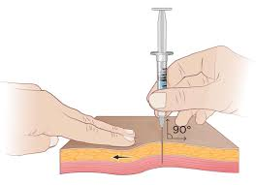
Give an IM shot

Slide 12
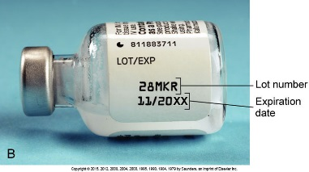
Chart notes
5 mL of Depro-Medrol 80 mg. given in left deltoid, manufacturer Merck, lot number 28MKR--L.Brammer, MA

Slide 13
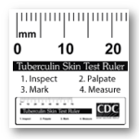
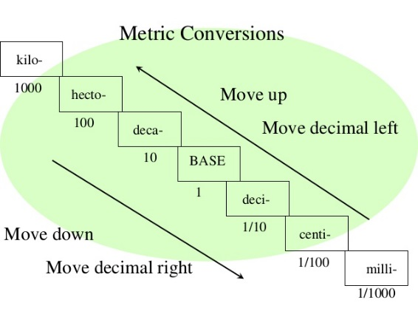
Measure in mL. There are 10 ml in one cm I ml = .1 cm and also = 1 cubic cm

Slide 14
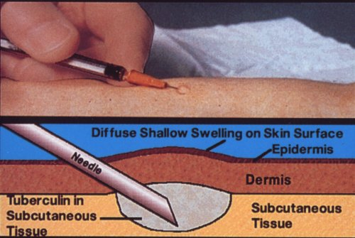
Tuberculosis tests= Monteux , TB, PPD, skin test. Negative is ≤5 ml ------≥ 10 ml is positive

Slide 15
Chart notes of TB test:
when given
Tubersol Mantoux test 5 TU, 0.1 mL. Merck labs Lot # CO832AA. Admin Rt. Anterior forearm ID. Pt to return on 2-17-2017 to have results read.
when read
Tubersol Mantoux test: 9 mm. Pt. provided with TB record card. Scheduled for TB retesting on 2-28-2017

Slide 16
Drug | Effects | Brand
Analgesic | To manage pain | Tylenol
Anesthetic | loss of feeling | Xylocain
Antacid | treat heartburn, indigestion etc. | Maalox
Antidepressant | treat depression & anxiety etc. | Prozac
Antidiabetic | treat diabetes mellitus | Glucotrol

Slide 17
Rx medication lists all the risks and benefits
In small print usually on the back of the page.
OTC (over the counter) ads do not.

Slide 18
Look up the classification on page 431 and find the | Brand name
vitamin/ Mineral supplement (Orange) | MVI multivitamin (OTC) I po qd One by mouth every day
Antihypertensive (Red) | Cardizem 30 mg I po bid
Diuretic (Yellow) | Lasix mg I po qod
Antidiabetic (Green) | Glucotrol 5 mg I po ac breakfast
Non-Narcotic Analgesic (Tylenol) (Brown) | Tylenol 500 mg I po prn pain Note: pt c/o pain qid sun, tid Wed, and bid Fri. No c/o on other days

Slide 19
AMOUNT ORDERED ______________ X VEHICLE = DOSE GIVEN AMOUNT ON HAND
Answers: 1=1/2 tab, 2=2 tabs, 3= ½ tab, 4=2 tabs, 5=4 tabs, 6=1 ½ tabs, 7=4 tabs, 8=1/2 mL., 9=4 mL. (10 $÷$5 x 2 mL= 4mL), 10= 25 mL

