Slide 1
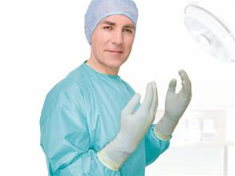
Surgery
Chapter 10
January 2017
Objectives:
The Sterile field
Sterile Dressings
Assist with surgery
Remove Sutures

Slide 2
Medical asepsis includes keeping objects or areas clean or free from infection.
Non-pathogens are still present, but all of the _germs or pathogens_ are removed
Surgical asepsis includes keeping objects and areas sterile or free from
all microoganisms

Slide 3
medical asepsis (M) or surgical asepsis: (S)
1. Administering oral medication: M | 2. Inserting sutures: S
3. Measuring oral temperature: M | 4. Applying a bandage to the forearm: M
5. Performing a needle biopsy: S | 6. Removing a sebaceous cyst: S
7. Obtaining a Pap smear: M | 8. Inserting a urinary catheter: S
9. Incision and drainage of an abscess: S | 10. Applying a dressing to an open wound: S

Slide 4
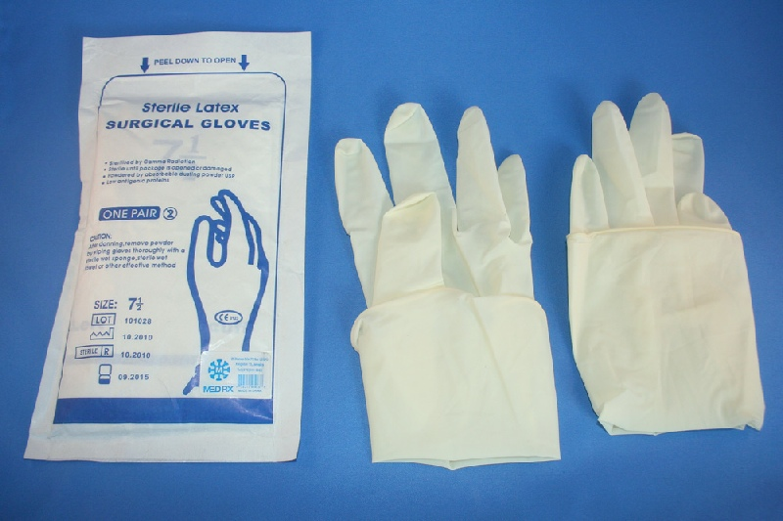
APPLY SURGICAL GLOVES

Slide 5
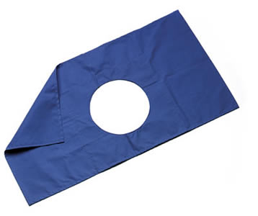
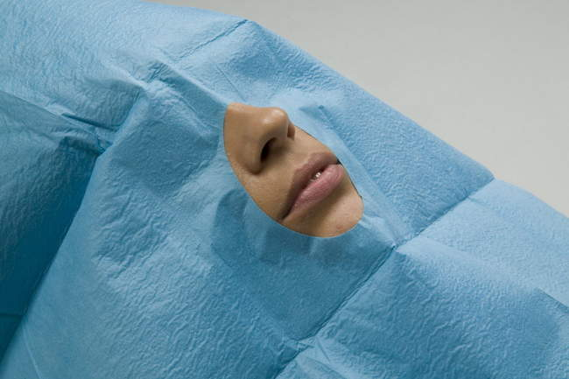
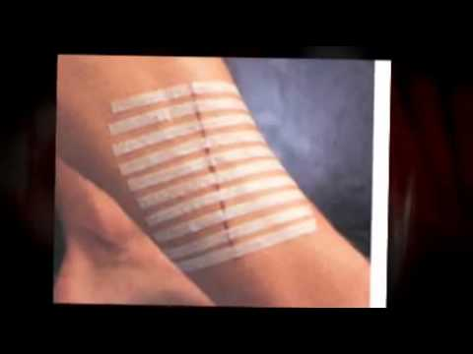
fenestrated drape skin closures

Slide 7
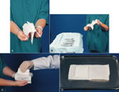
Sterile tray set-up wound dressing

Slide 8
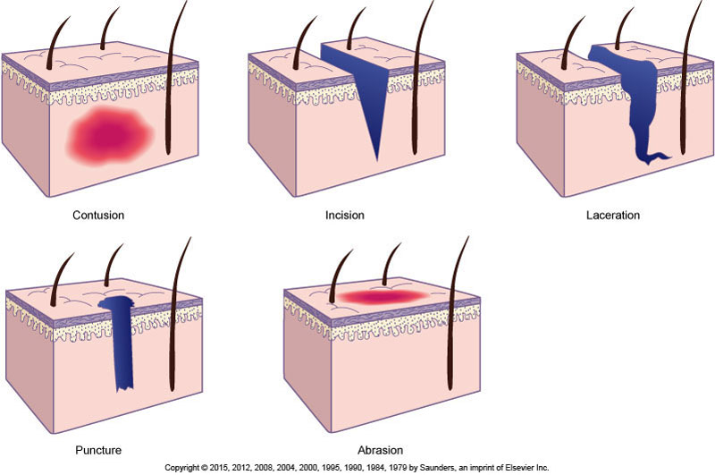
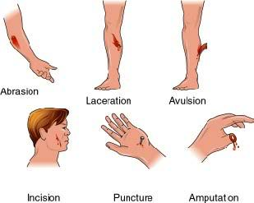
Types of wounds

Slide 9
THICKER needles in each group
A = 2-0
B= 3-0

Slide 10
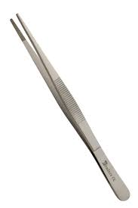
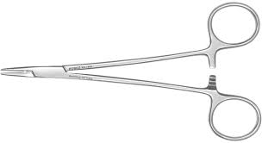
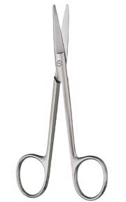
Suture tray set-up
Doctor
Needle holder forceps
Gauze scissors
Medical assistant

Slide 11
To stop bleeding apply pressure

Slide 13
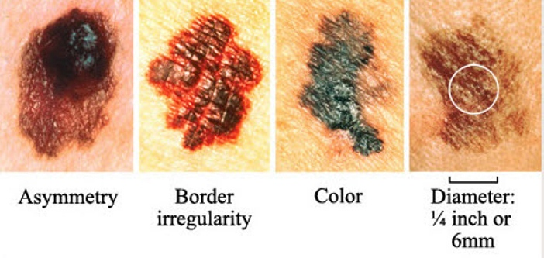
Signs of melanoma (cancer)

